Slide 1
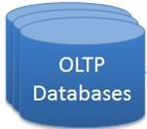
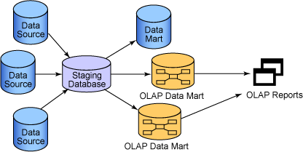
Operational Data Store (ODS)
OLTP : OnLine Transaction Processing
OLAP : (onLine Analytical Processing)
1

Slide 2
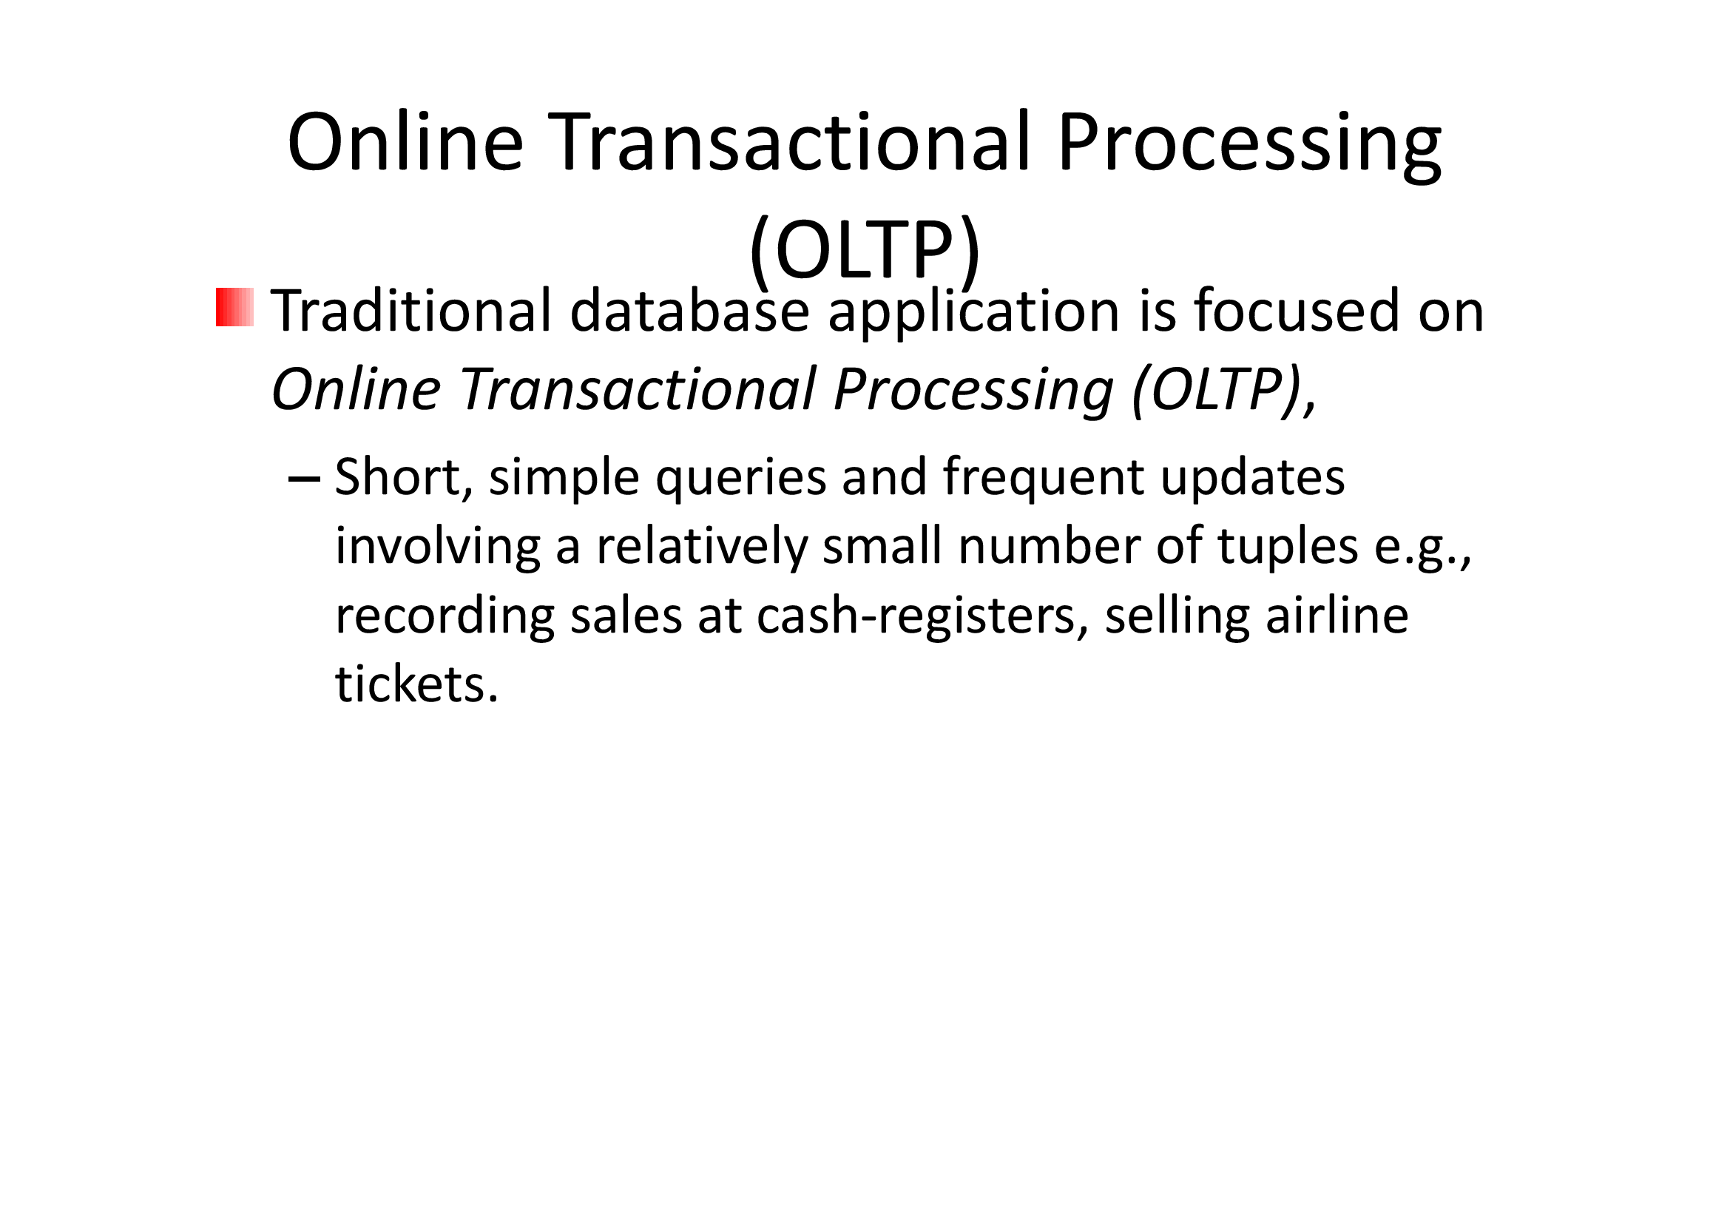

Slide 3
Operational Data Store (ODS)
OLTP (onLine Transaction Processing)
  Major task of traditional relational DBMS
  Day-to-day operations:
    purchasing,
    inventory,
    banking,
    manufacturing,
    payroll,
    registration,
    accounting, etc.
5

Slide 4
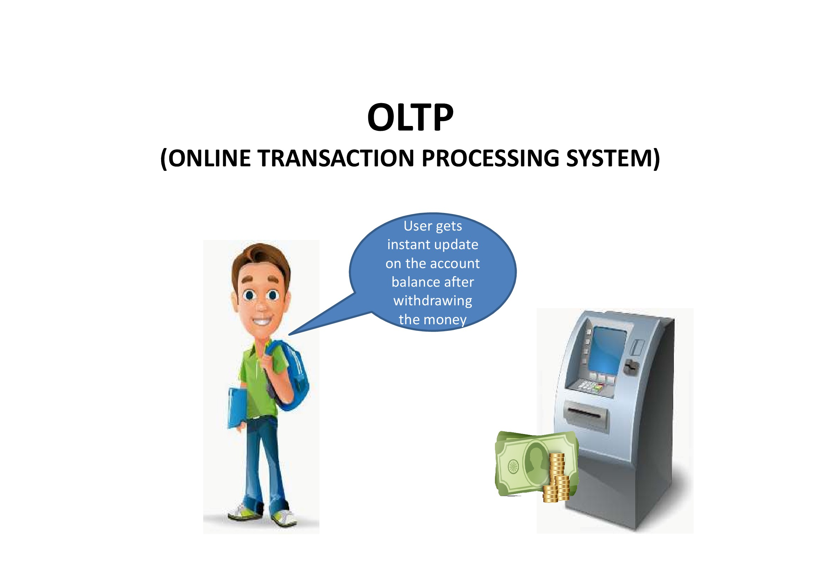

Slide 5
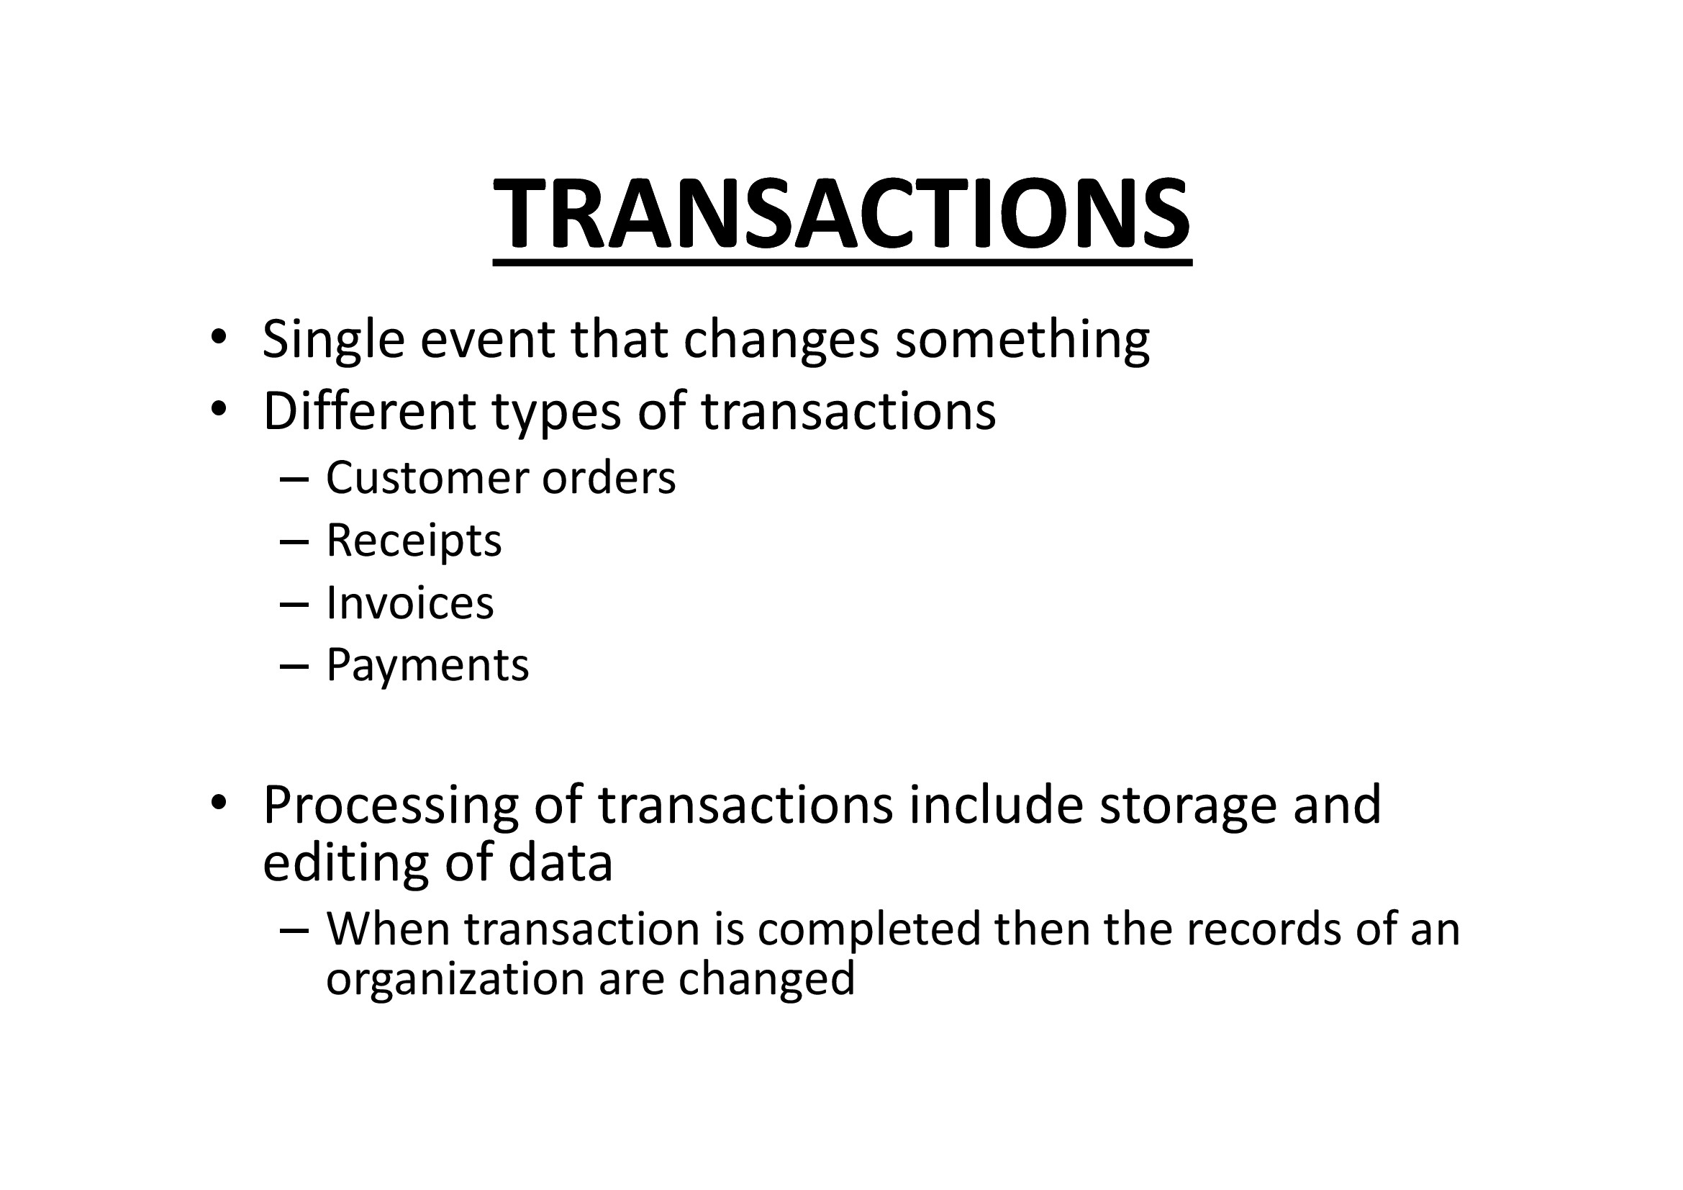

Slide 6
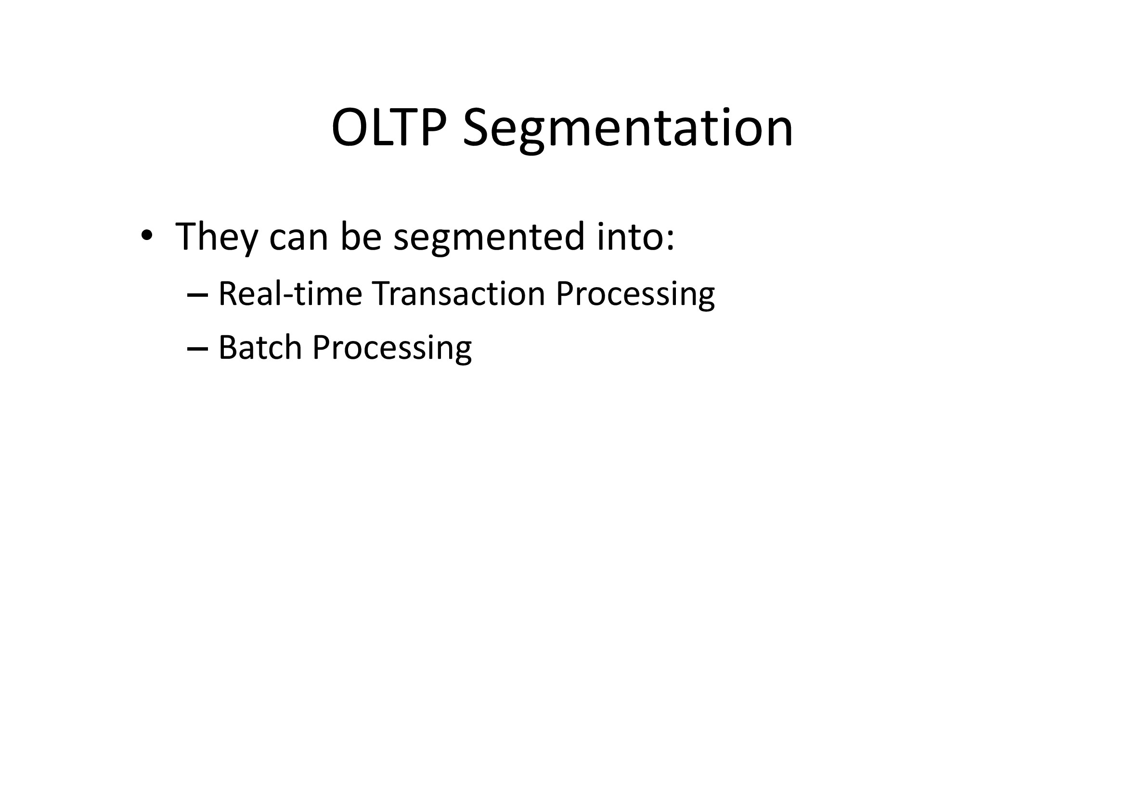

Slide 7
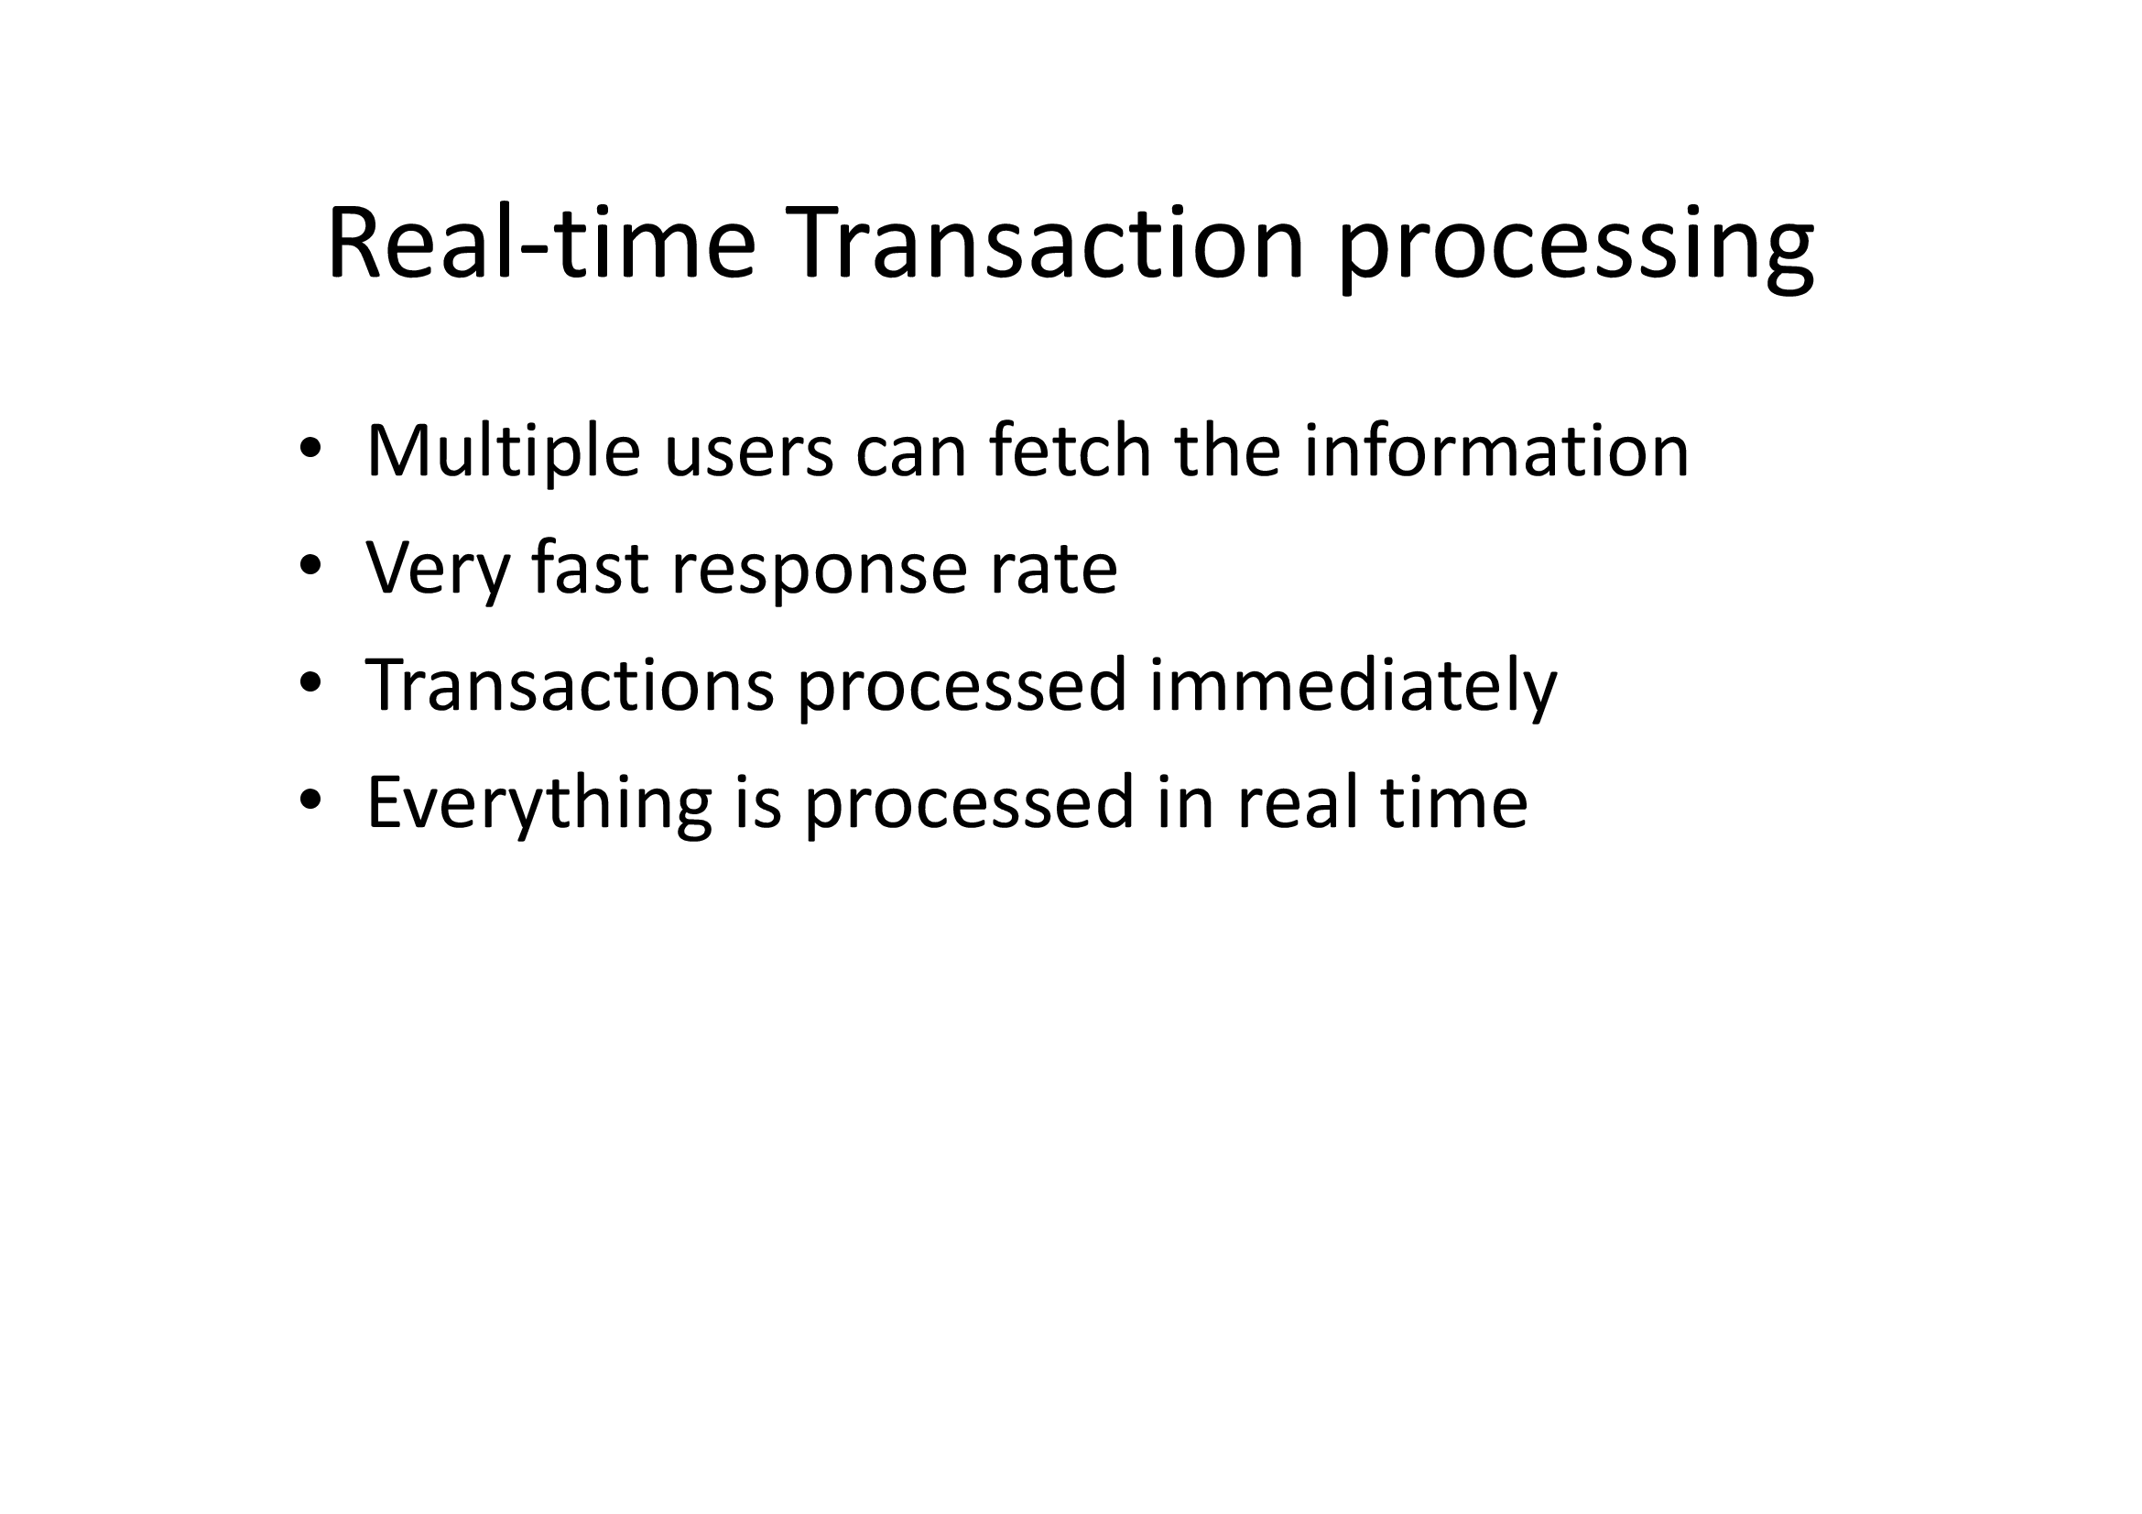

Slide 8
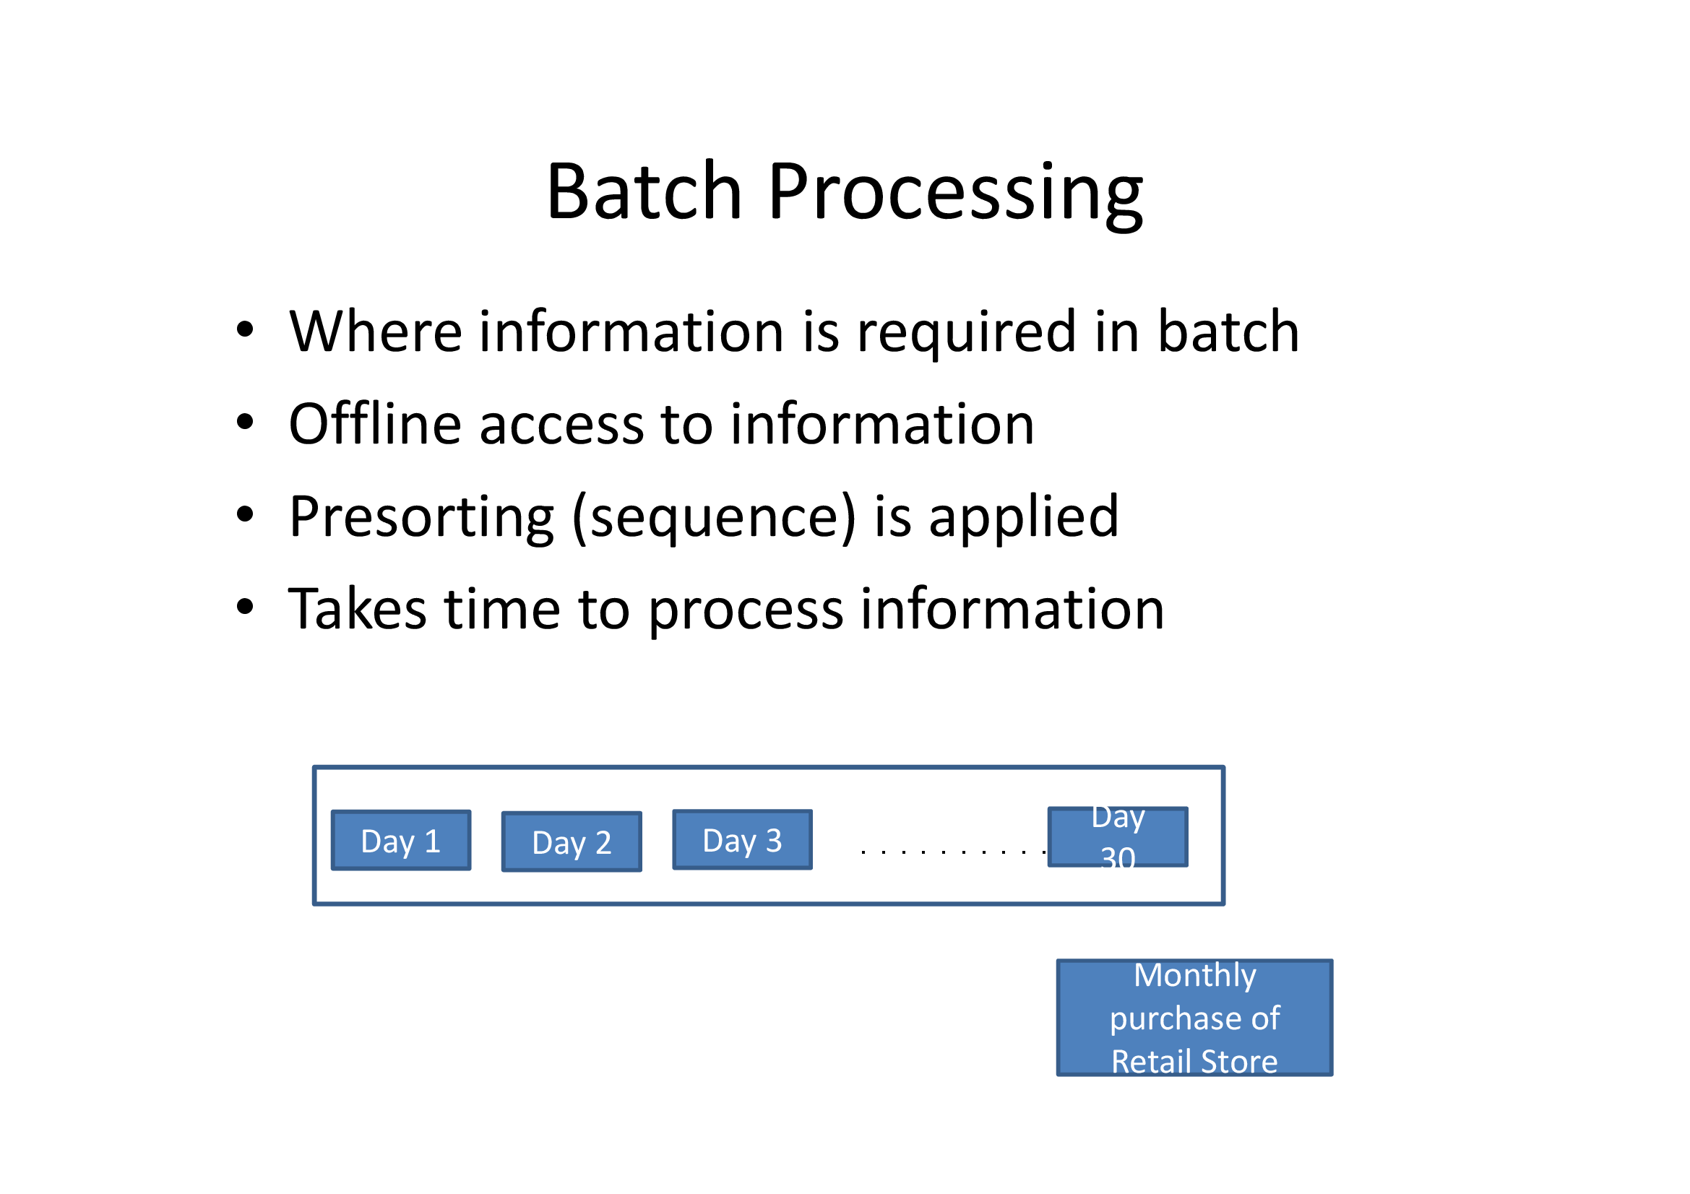

Slide 9
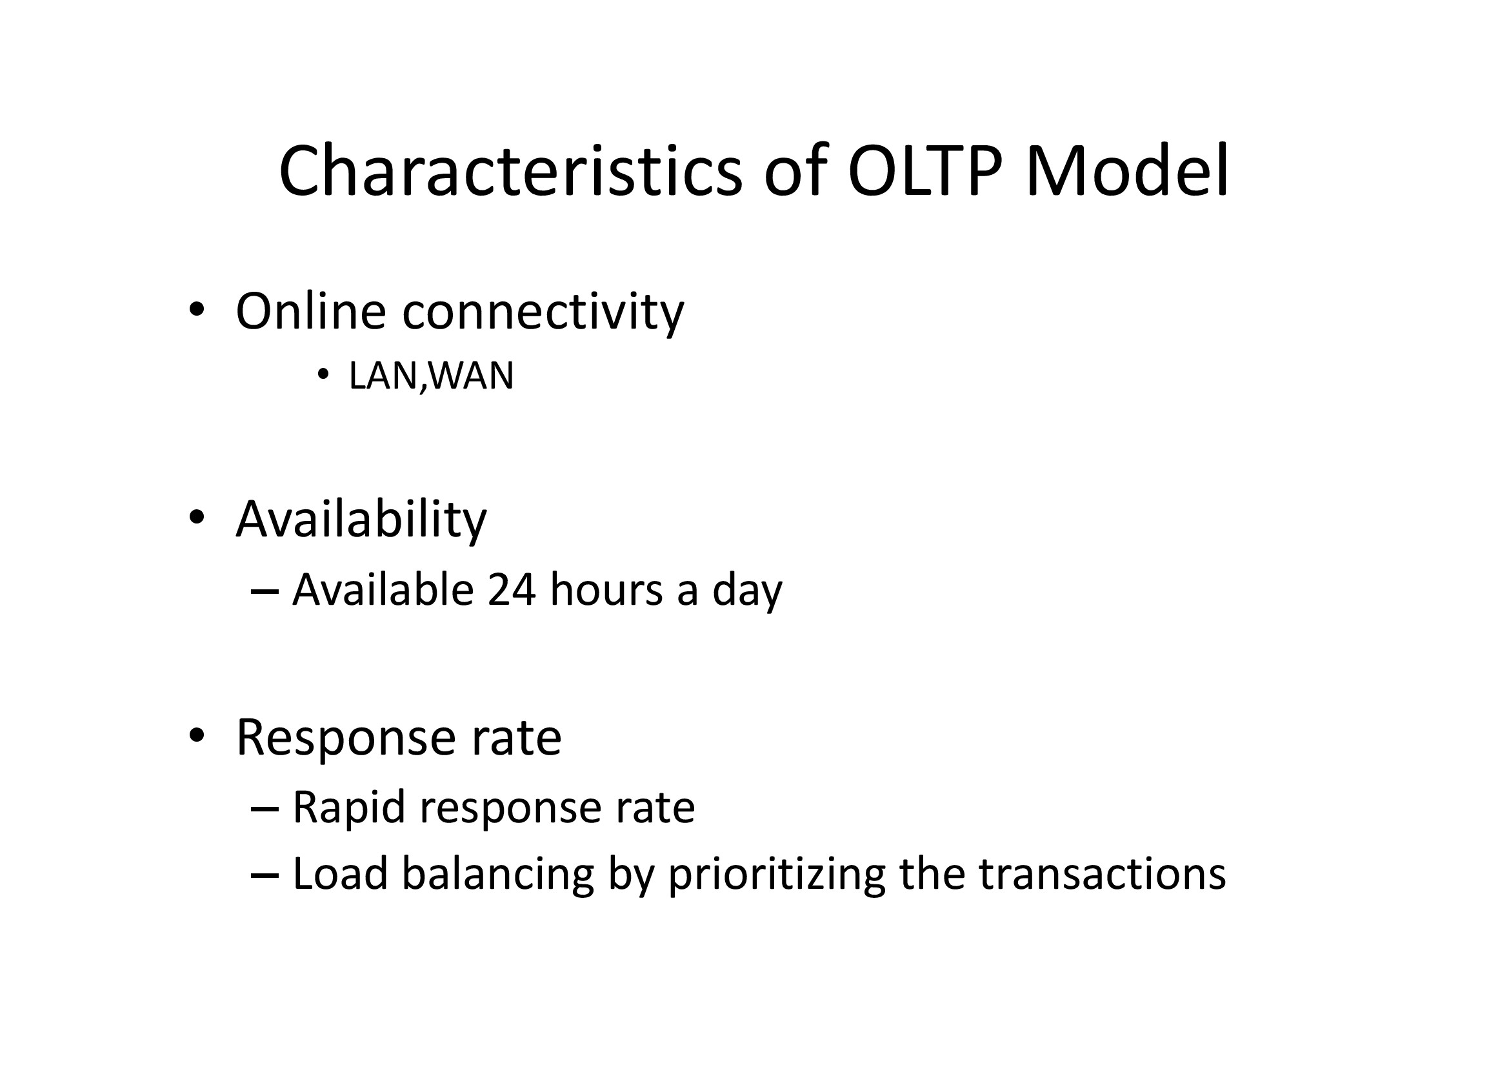

Slide 10
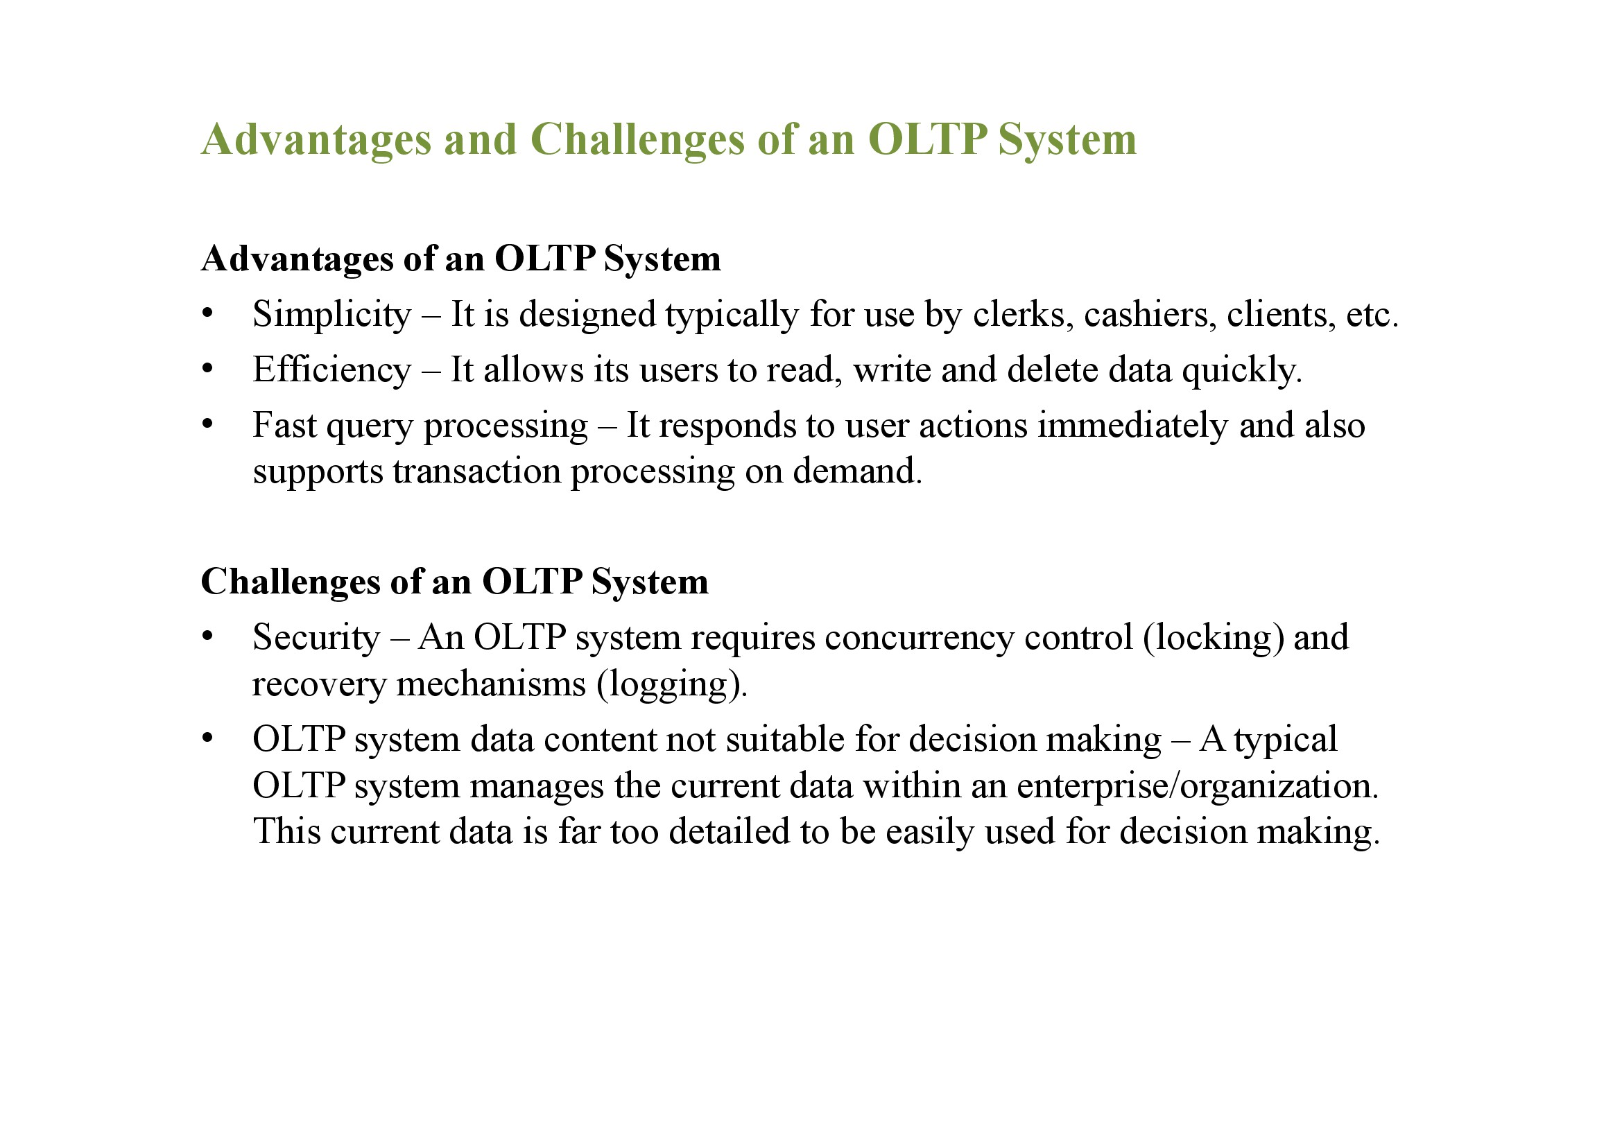

Slide 11
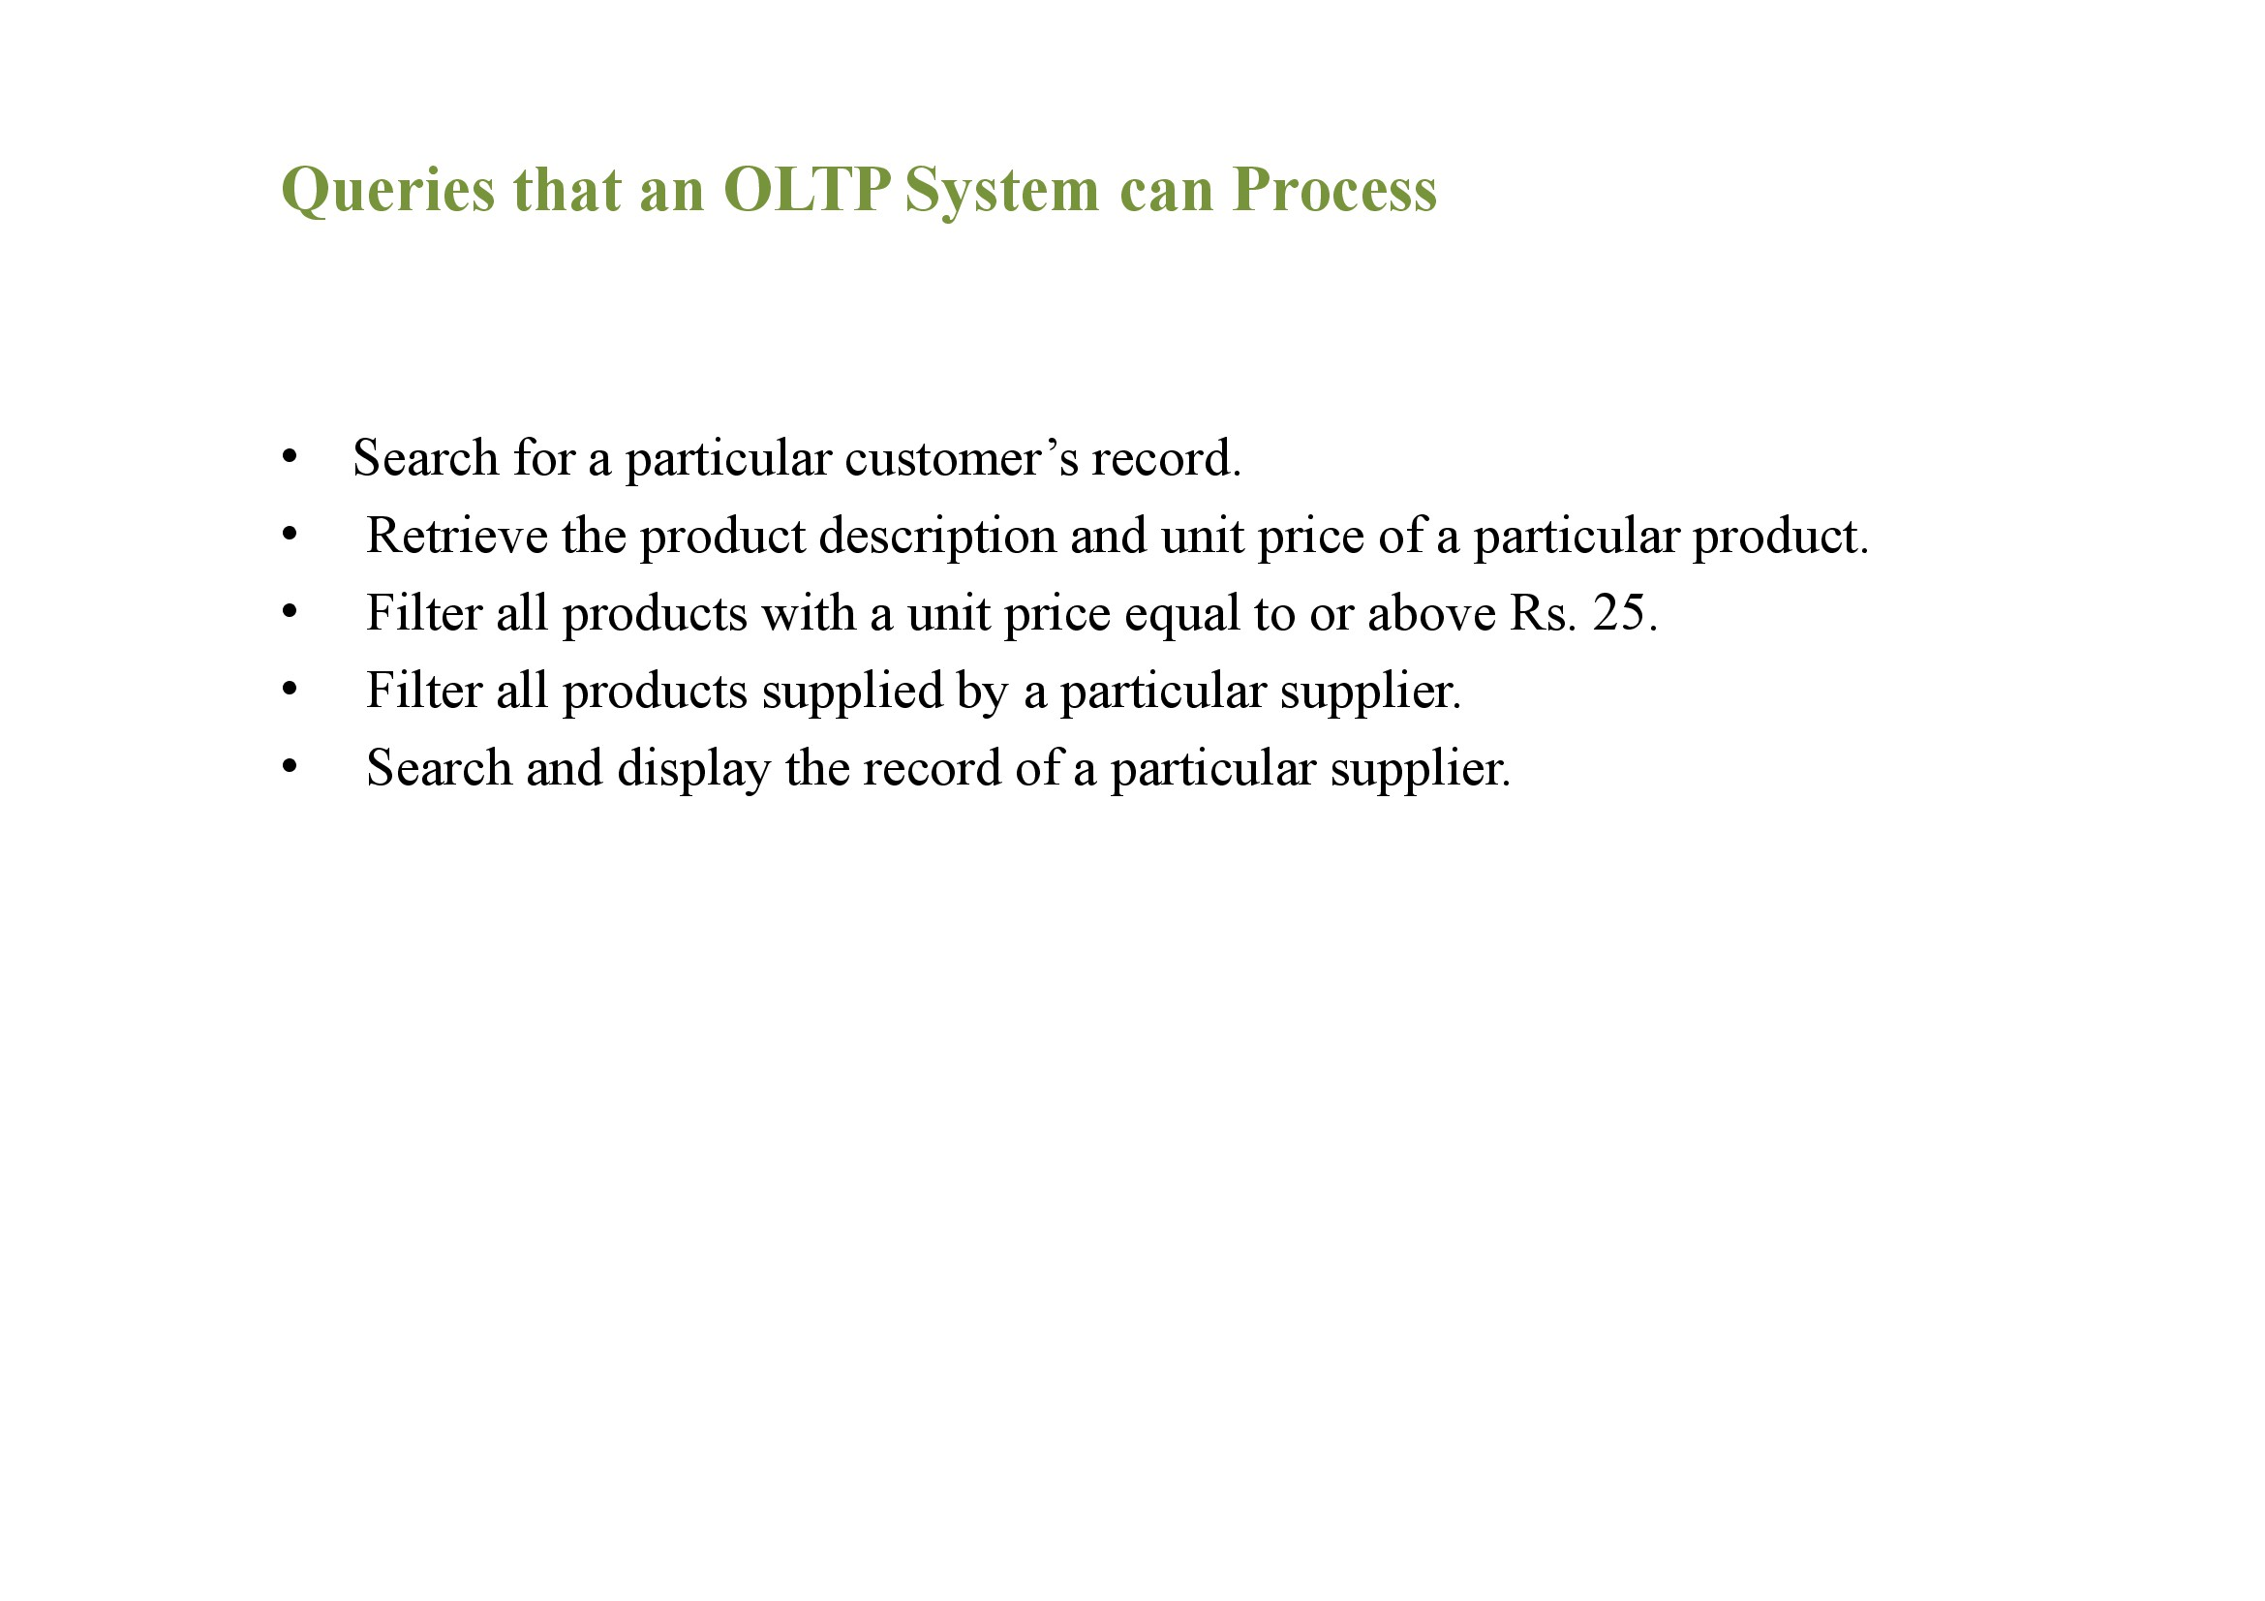

Slide 12
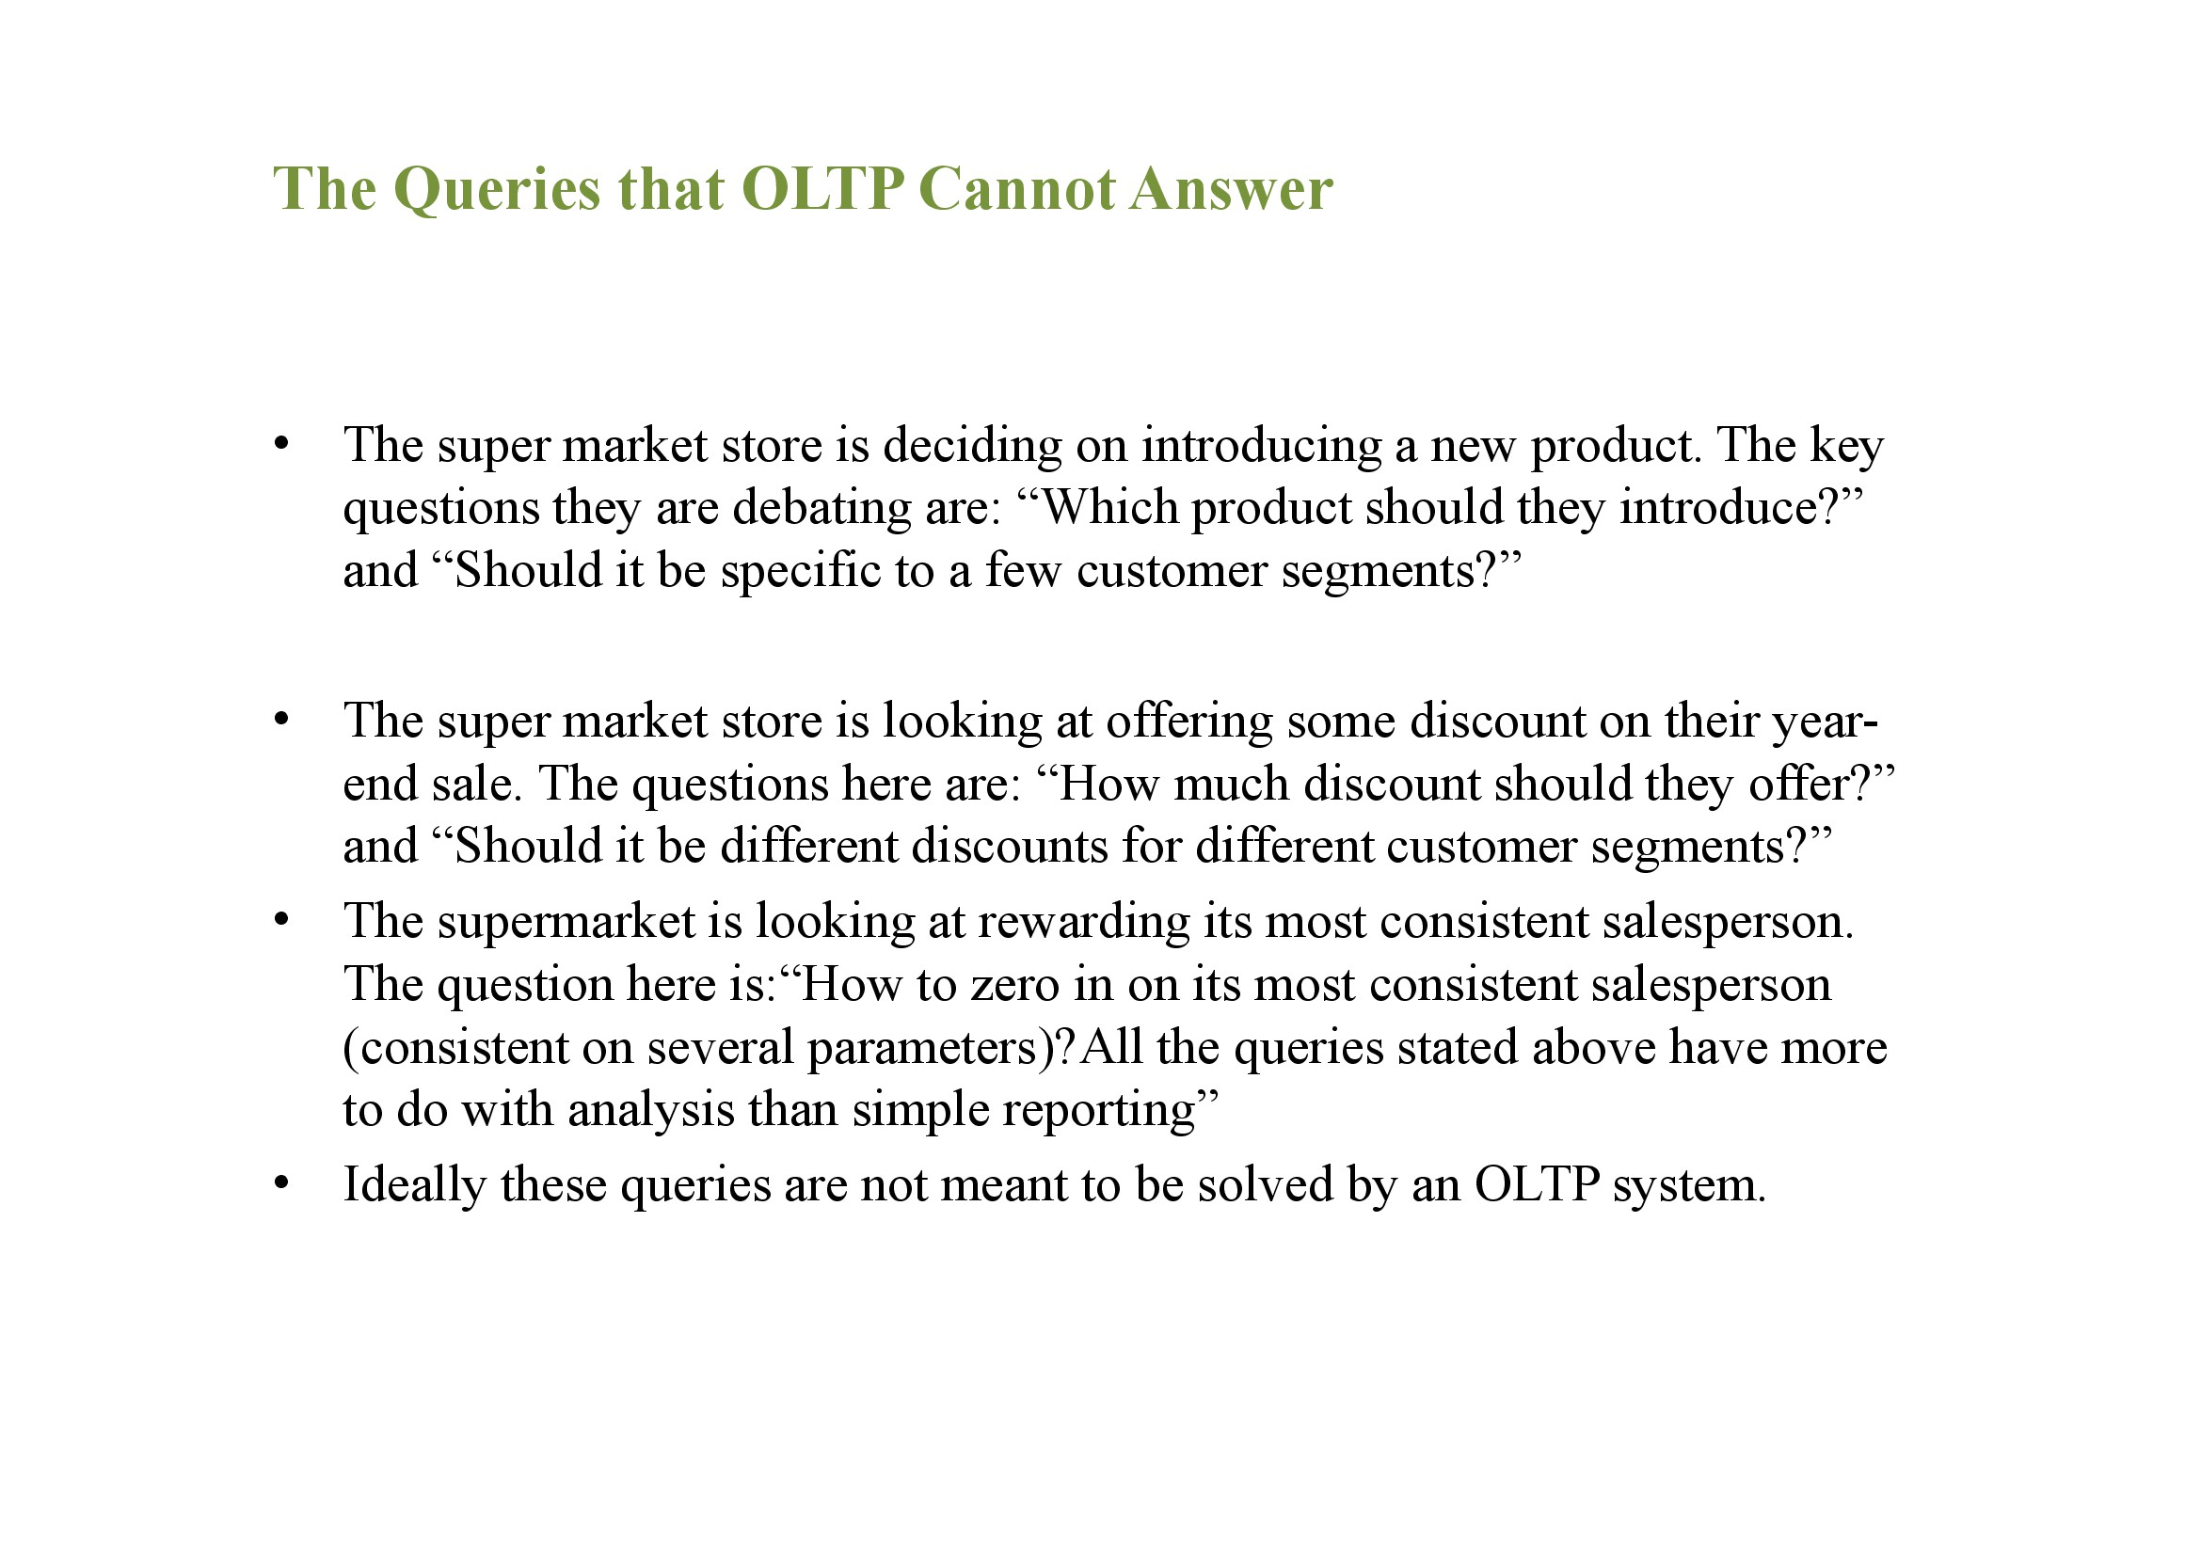

Slide 13
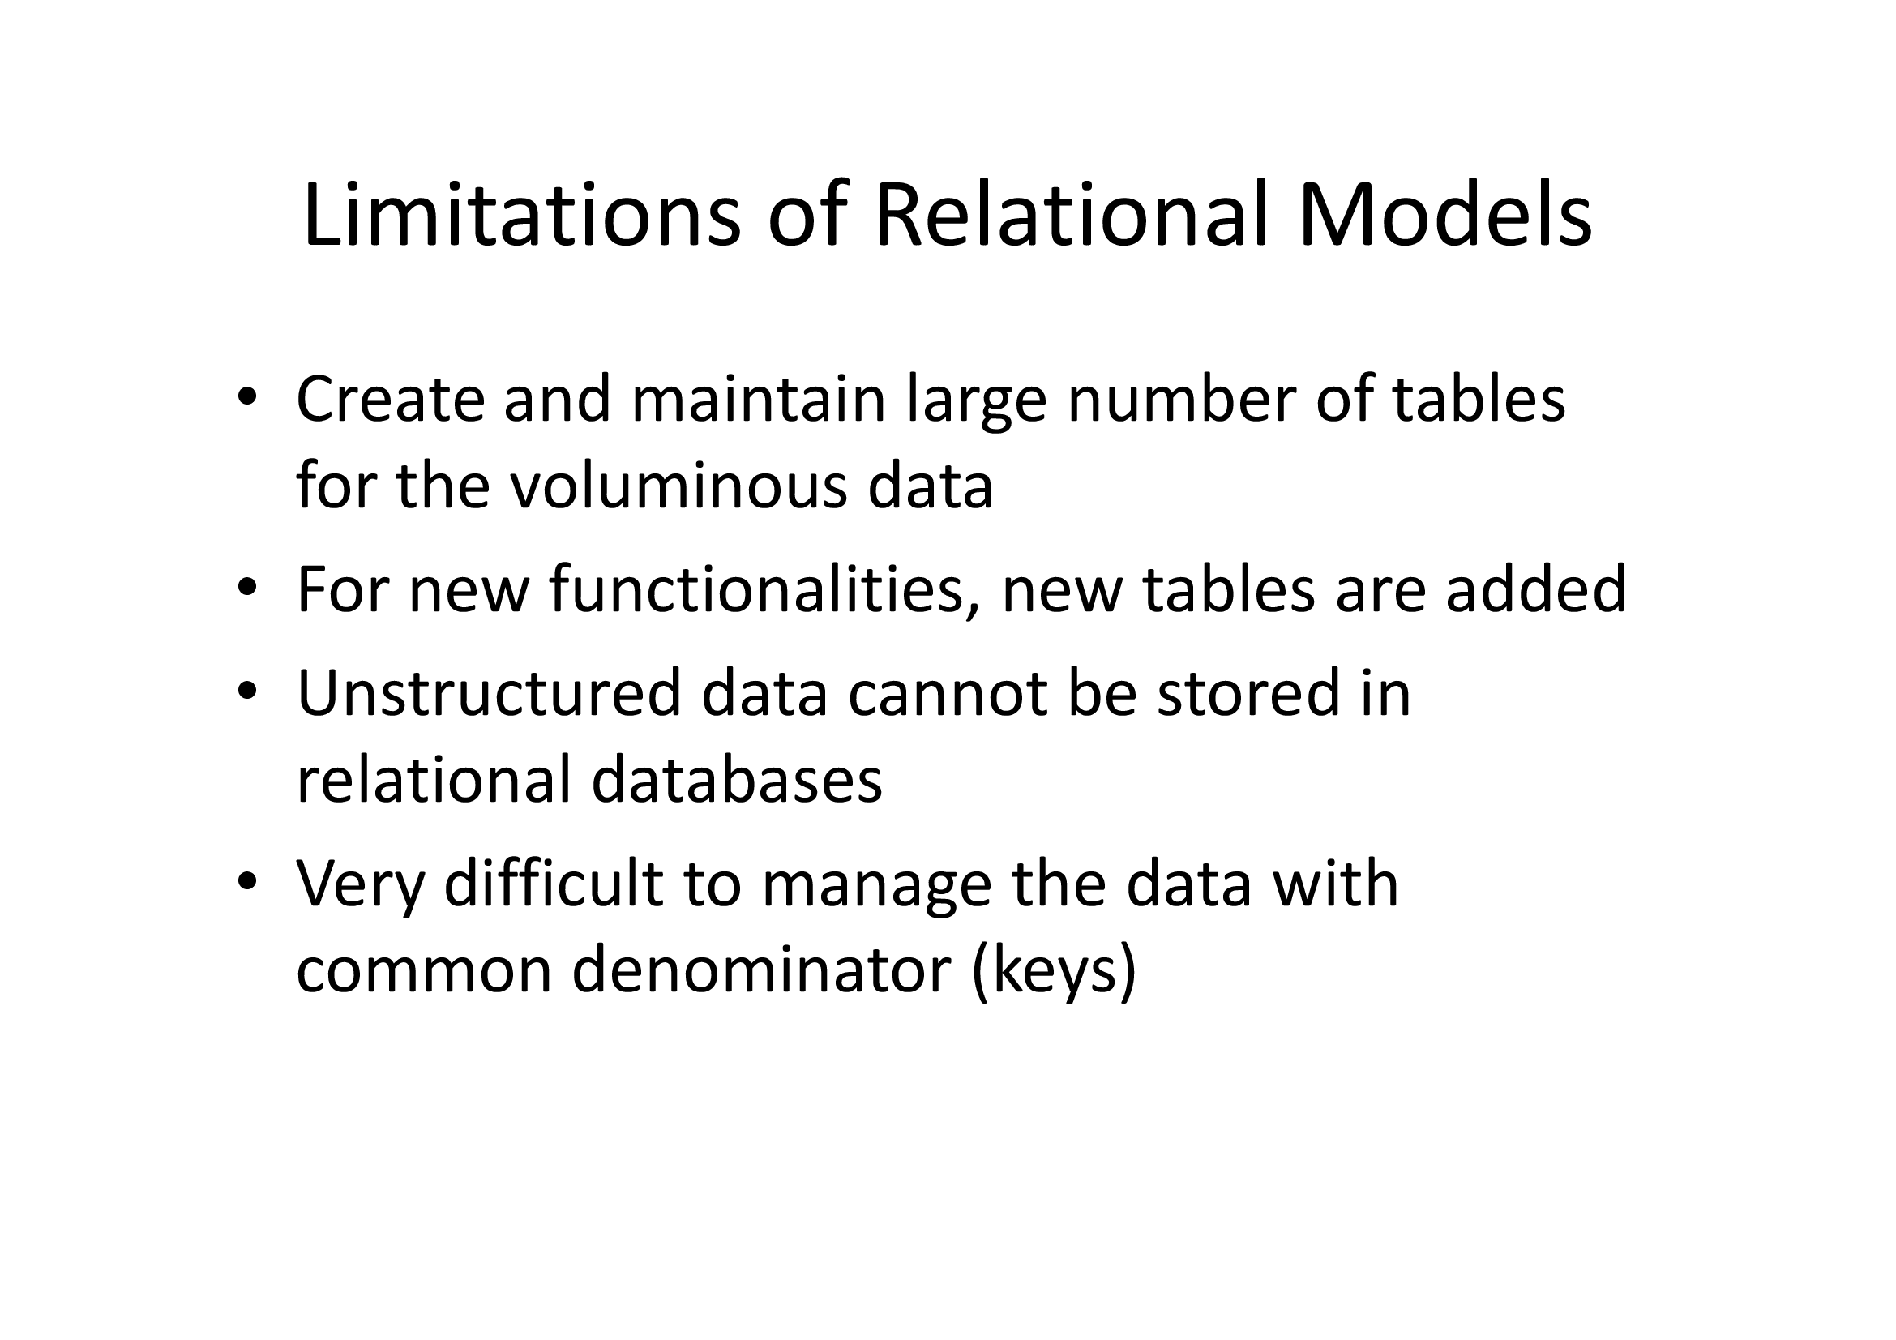

Slide 14
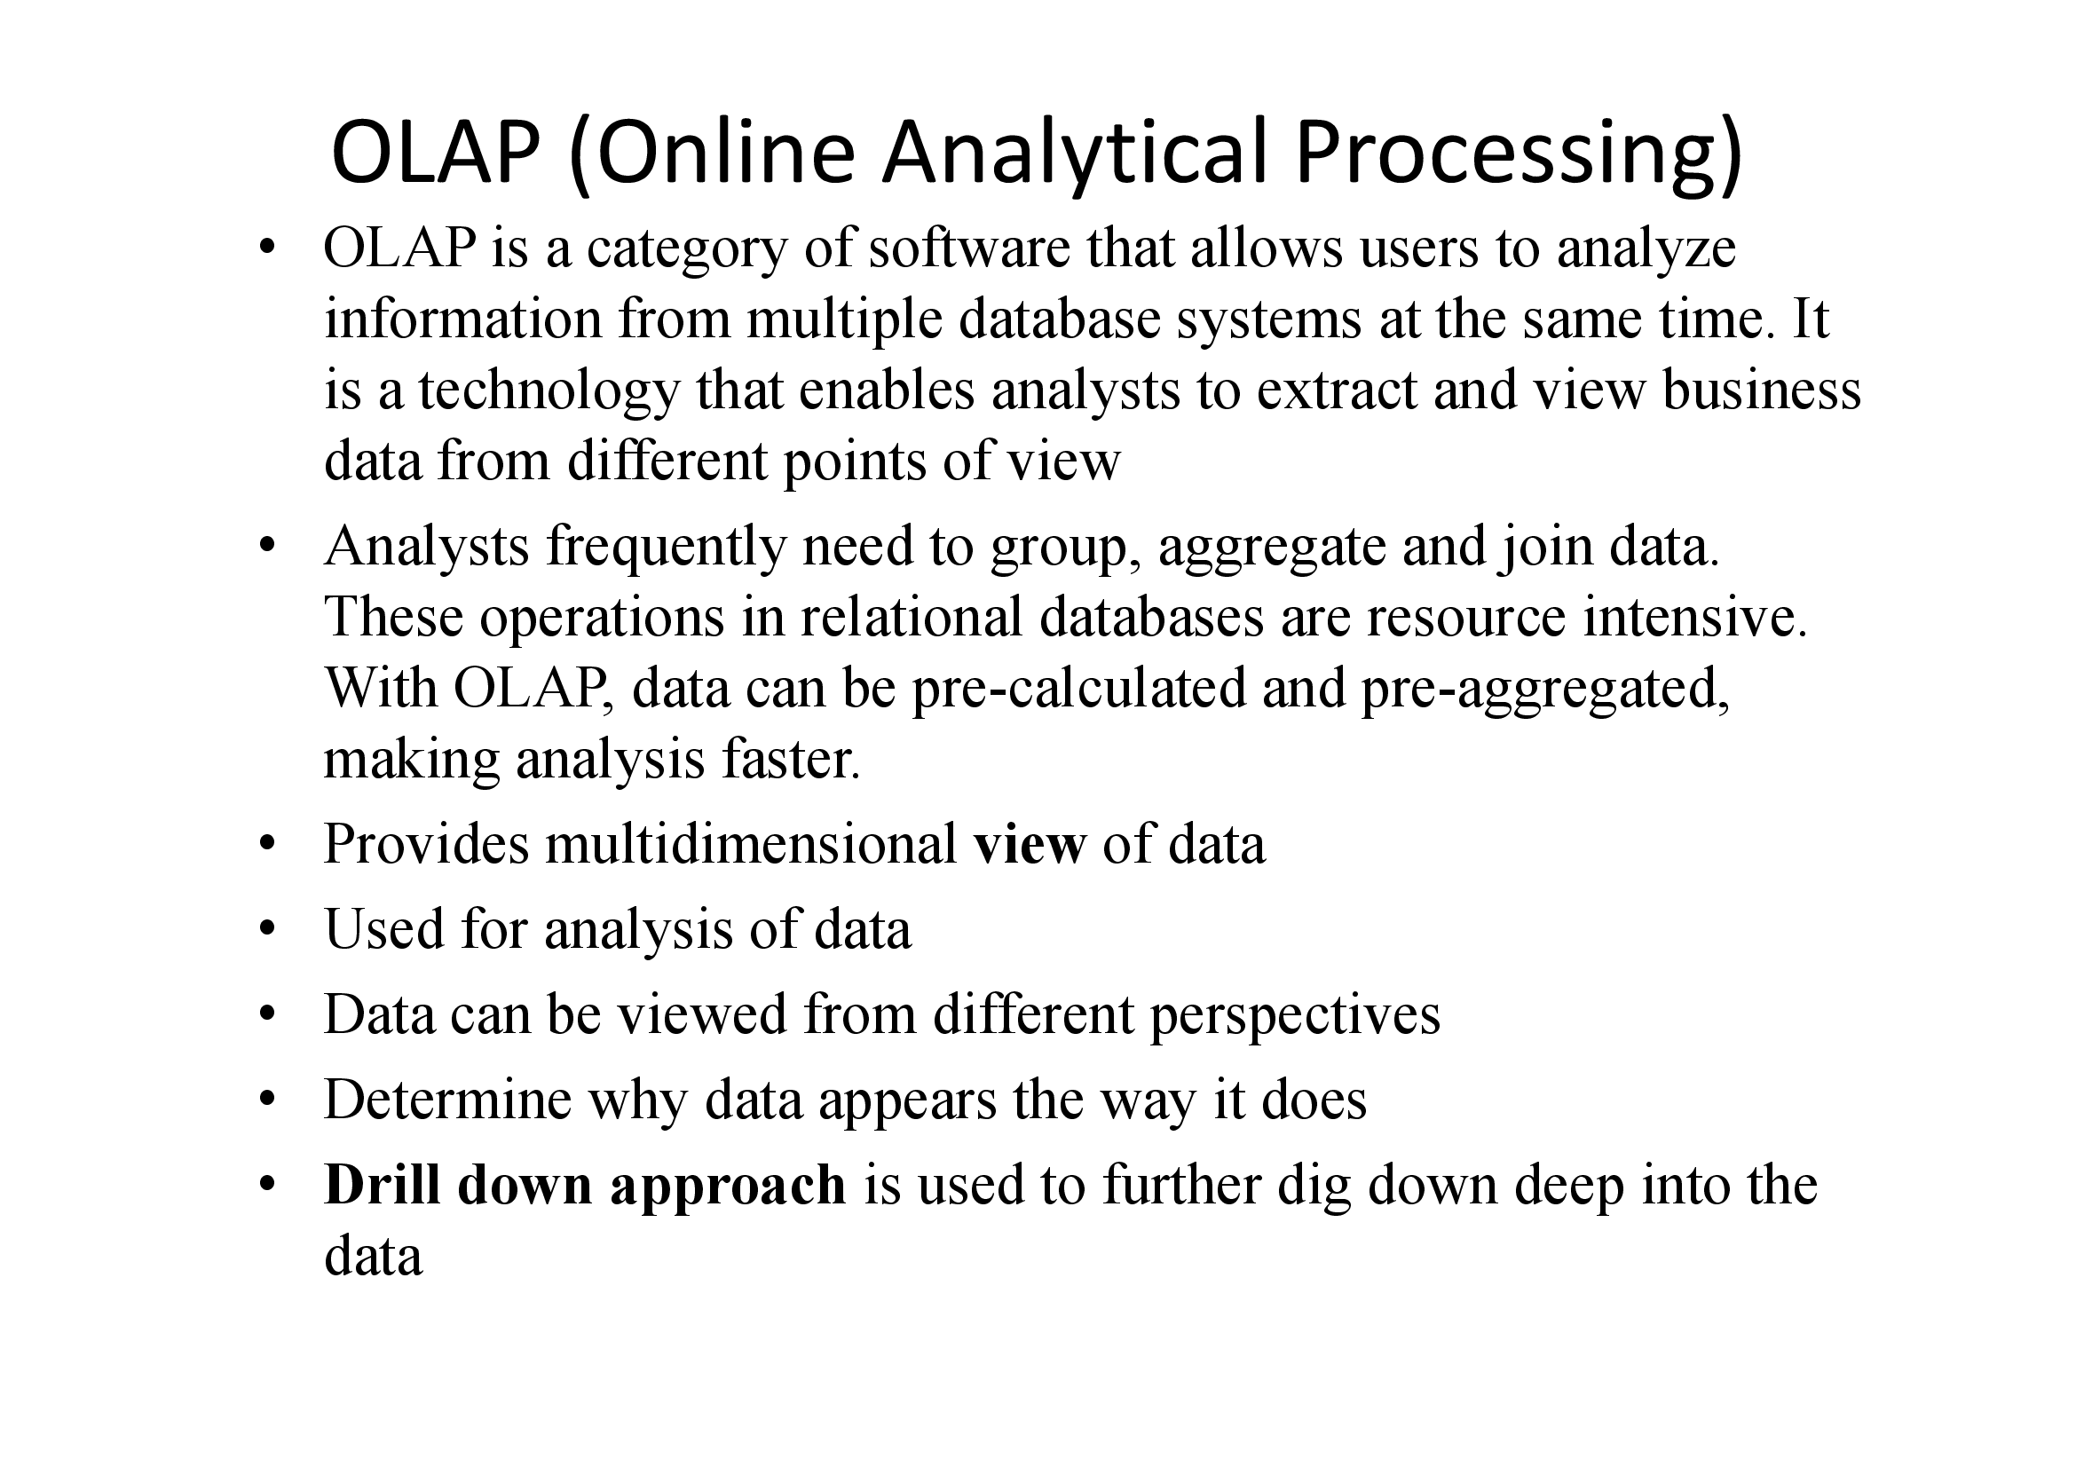

Slide 15
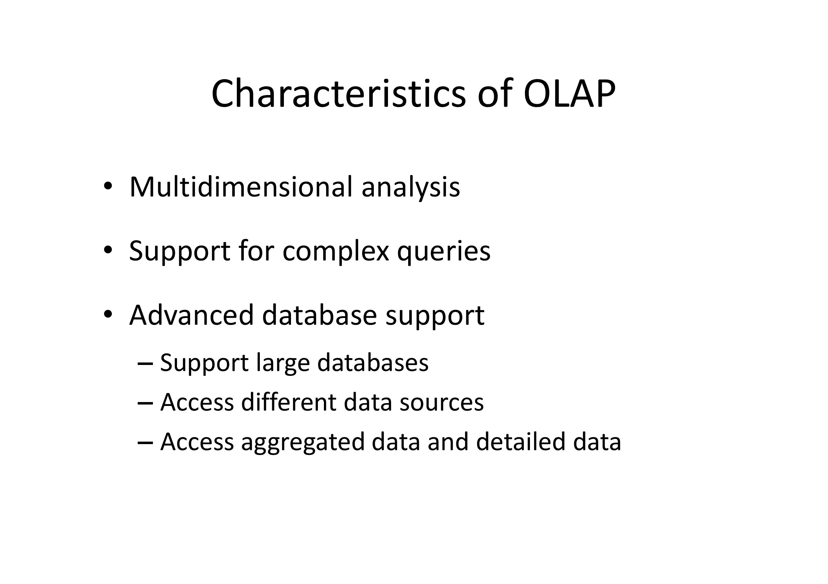

Slide 16
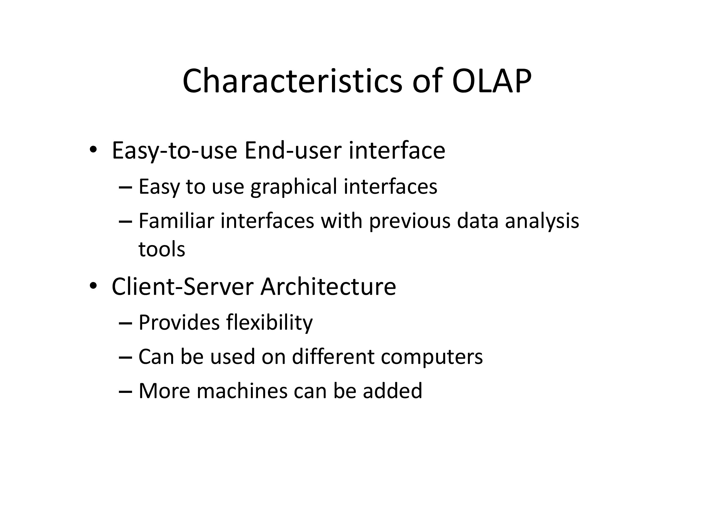

Slide 17
Data Warehouse
OLAP (onLine Analytical Processing)
Major task of data warehouse system
  Data analysis and decision making
  Tools for querying huge multi-dimensional dbs.
  Tools for domain specialists
17

Slide 18
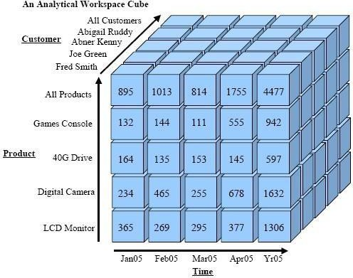
Data Warehouse
18

Slide 19
OLTP vs. OLAP
OLTP: On-Line Transaction Processing
  Concerned with processing at operational sites
  Mostly using some kind of database
OLAP: On-Line Analytical Processing
  Describes processing at warehouse
  Data is used for analysis only
  Used by management/strategists/planners
19

Slide 20
Warehouse as Specialized DB
Standard DB (OLTP)
Mostly updates
Many small transactions
Mb-GB of data
Current snapshot
Index/hash on PK
Raw data
Thousands of users
Warehouse (OLAP)
Mostly reads
long & complex queries
Gb-Tb of data
History
Lots of scans
Summarizes data
Hundreds of users
20

Slide 21
Data Warehouse vs. Operational DBMS
 | OLTP | OLAP
User and system orientation | customer | market
Data contents | current, detailed | historical, consolidated
Database design | ER + application | star + subject
View | current, local | evolutionary, integrated
Access patterns | update | read-only but complex queries
21

Slide 22
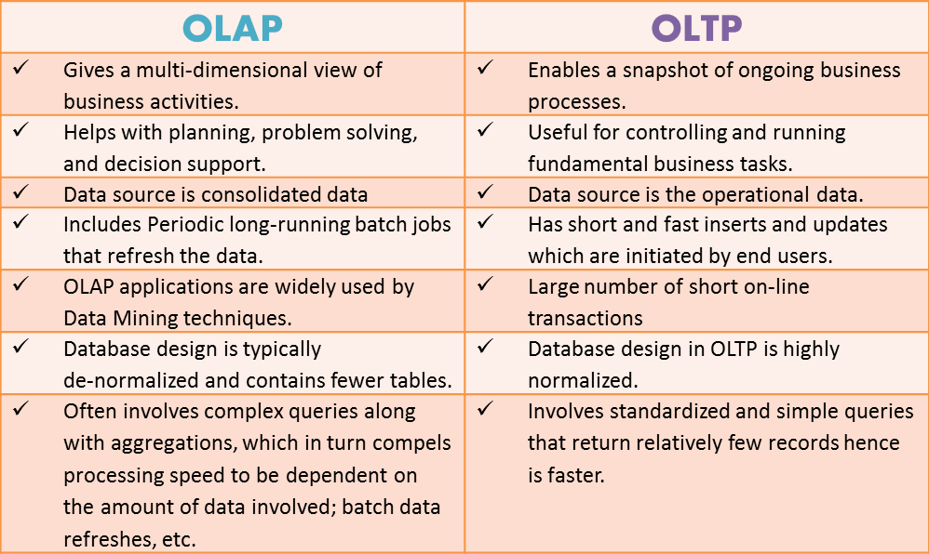
Data Warehouse vs. Operational DBMS
22

Slide 23
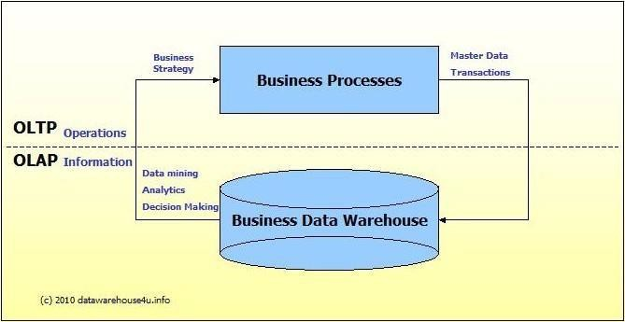
Data Warehouse vs. Operational DBMS
23

Slide 24
Why Separate Data Warehouse?
High performance for both systems:
  DBMS— tuned for OLTP: access methods, indexing, concurrency control, recovery
  Warehouse—tuned for OLAP: complex OLAP queries, multidimensional view, consolidation.
24

Slide 25
Why Separate Data Warehouse?
Different functions and different data:
  missing data: Decision support(DS) requires historical data which operational DBs do not typically maintain
  data consolidation: DS requires consolidation (aggregation, summarization) of data from heterogeneous sources
  data quality: different sources typically use inconsistent data representations, codes and formats which have to be reconciled
25

Slide 26
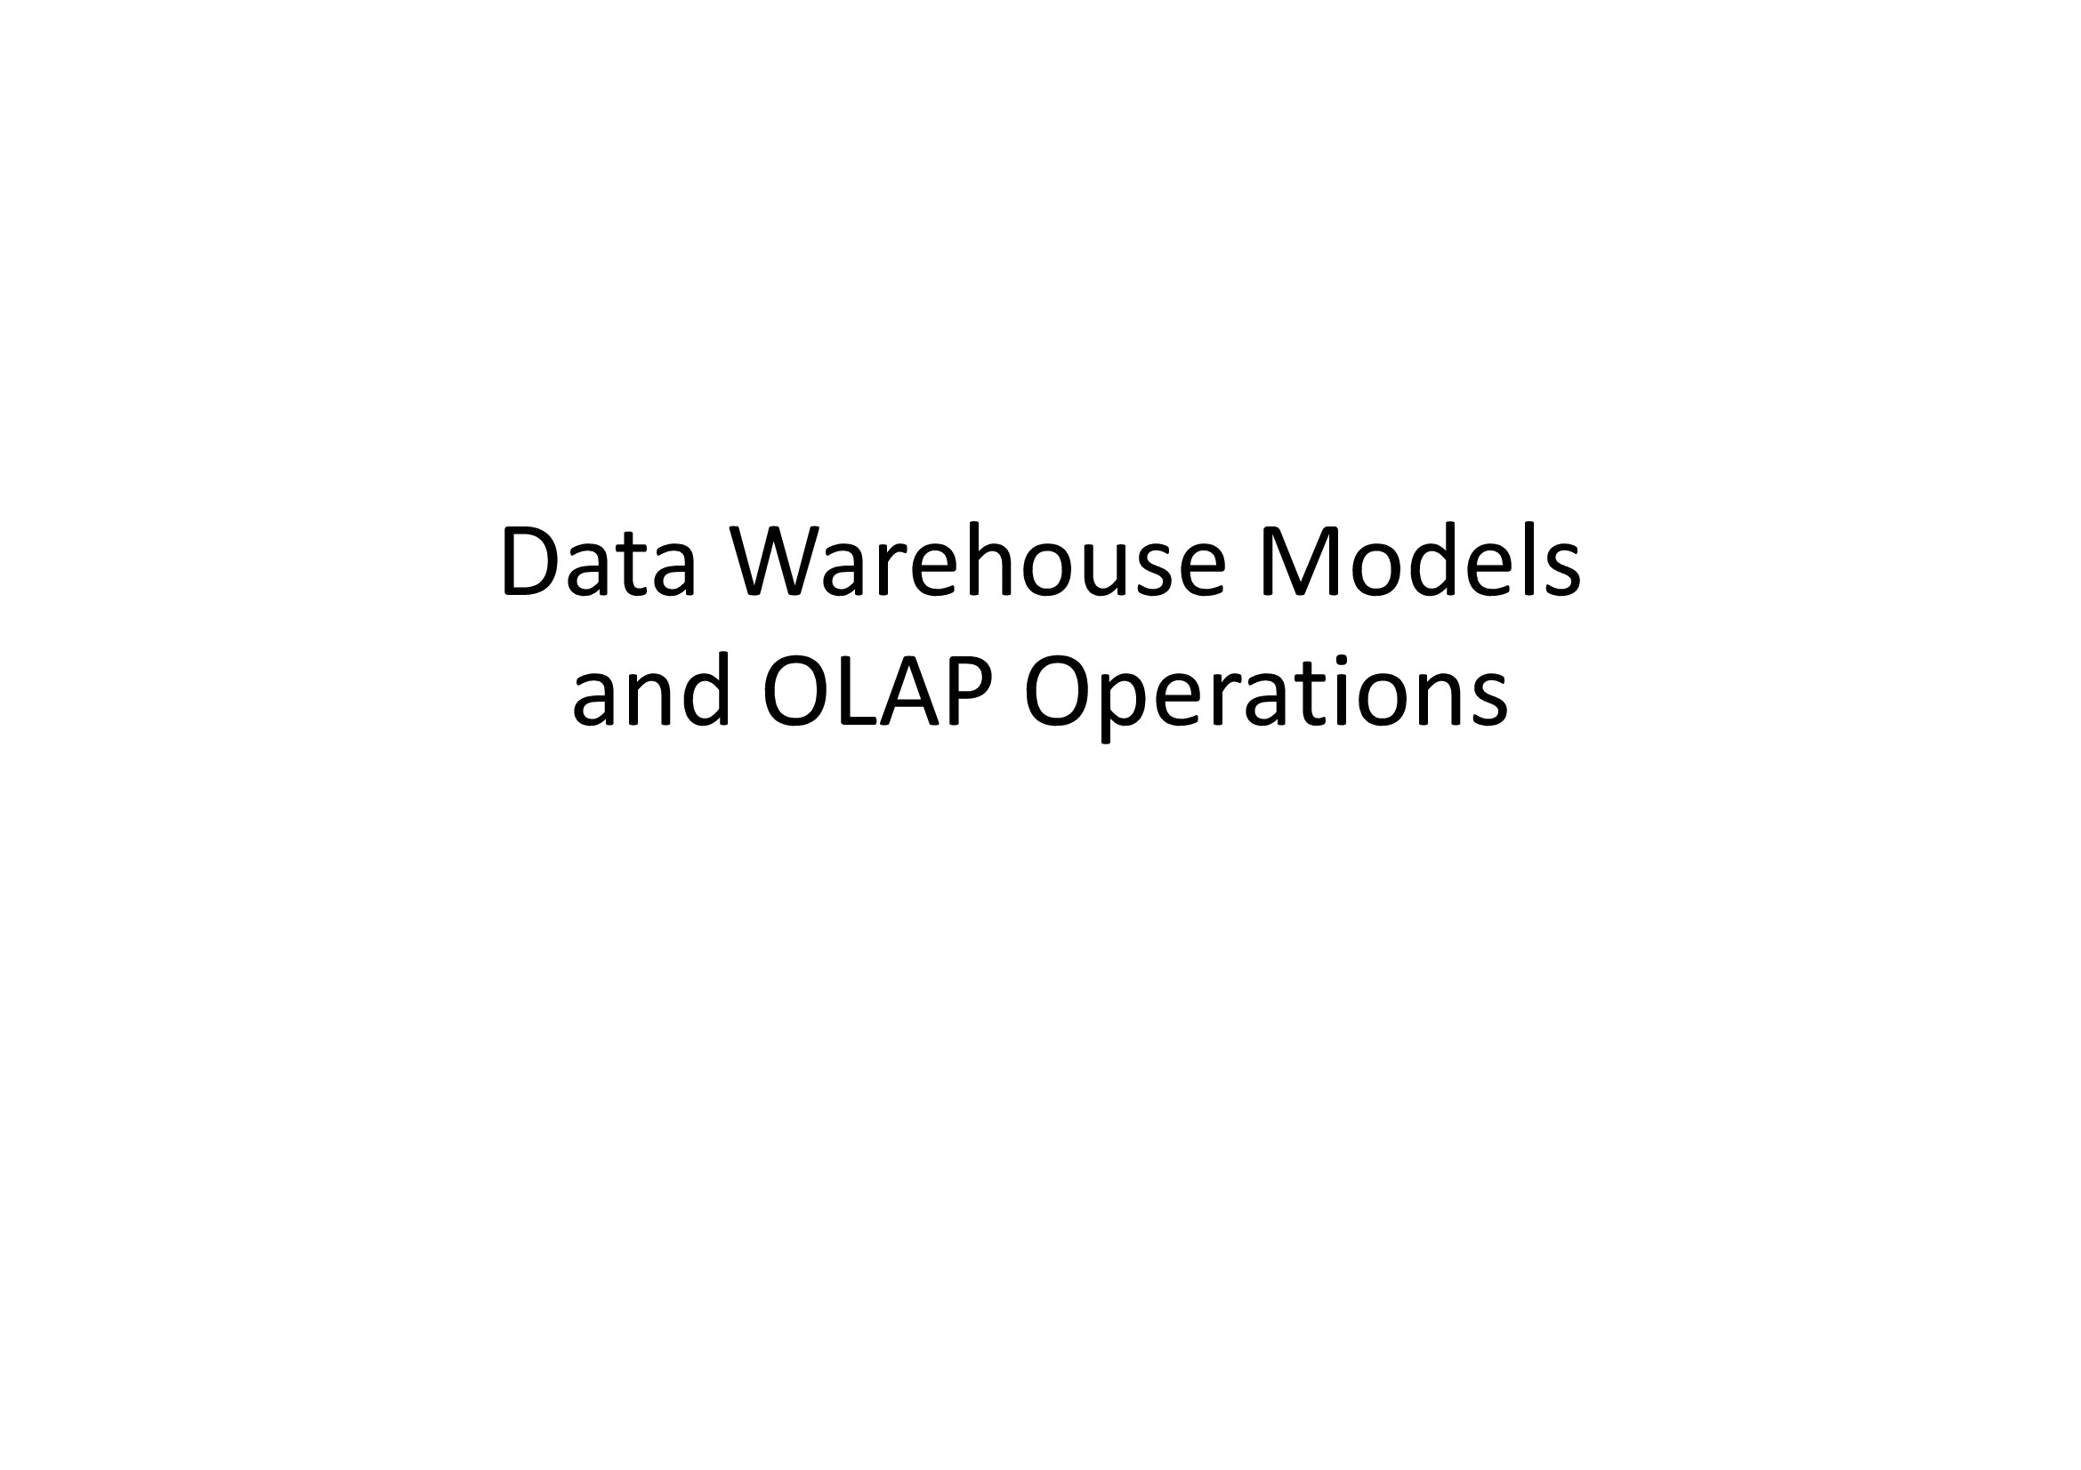

Slide 27
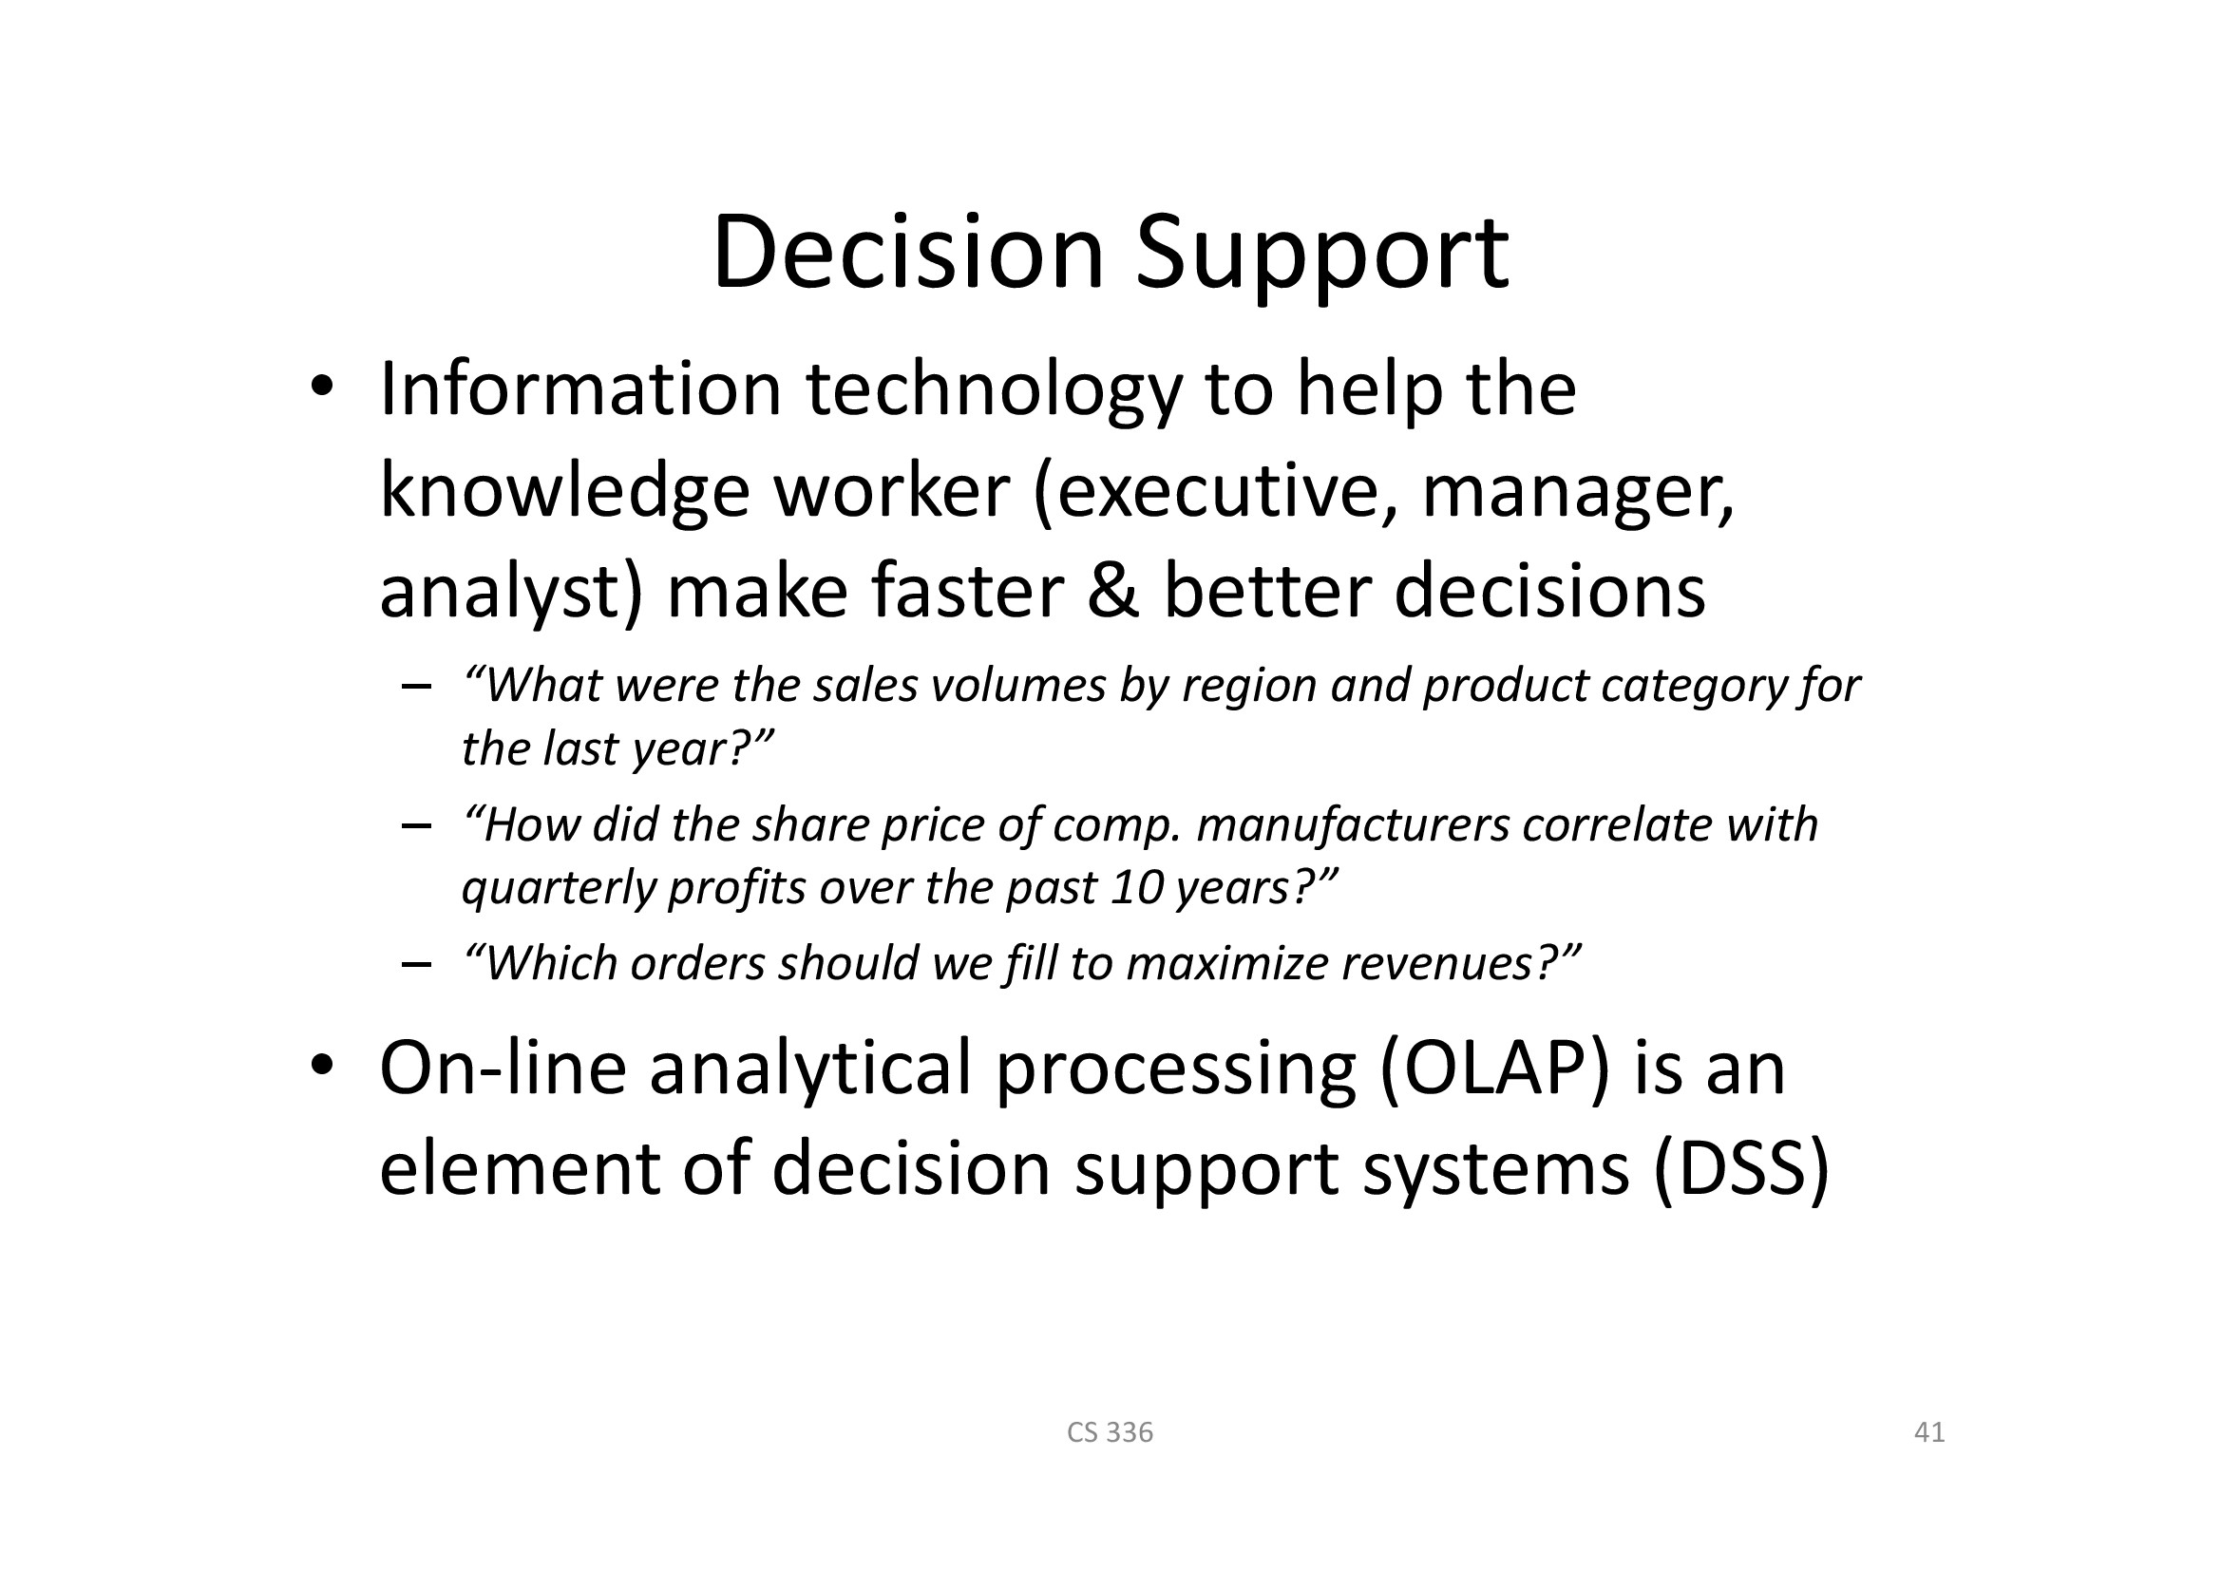

Slide 28
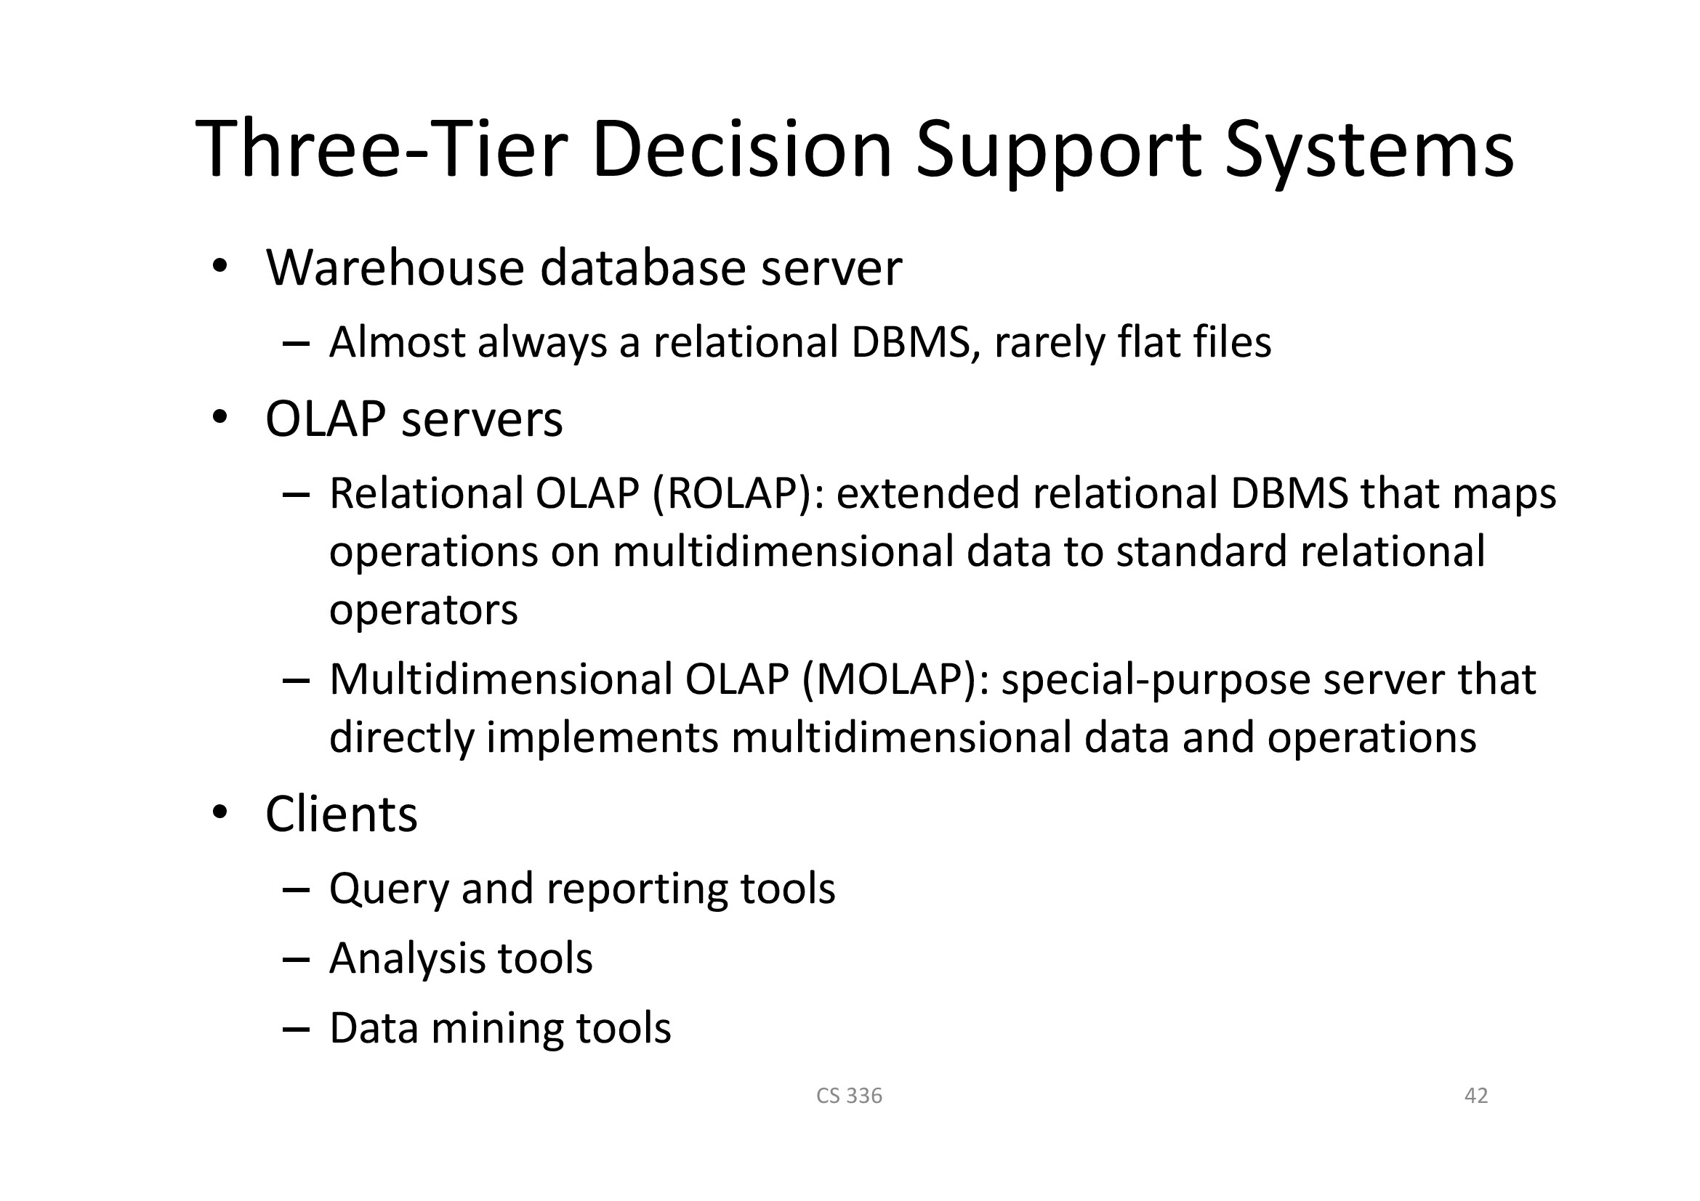

Slide 29
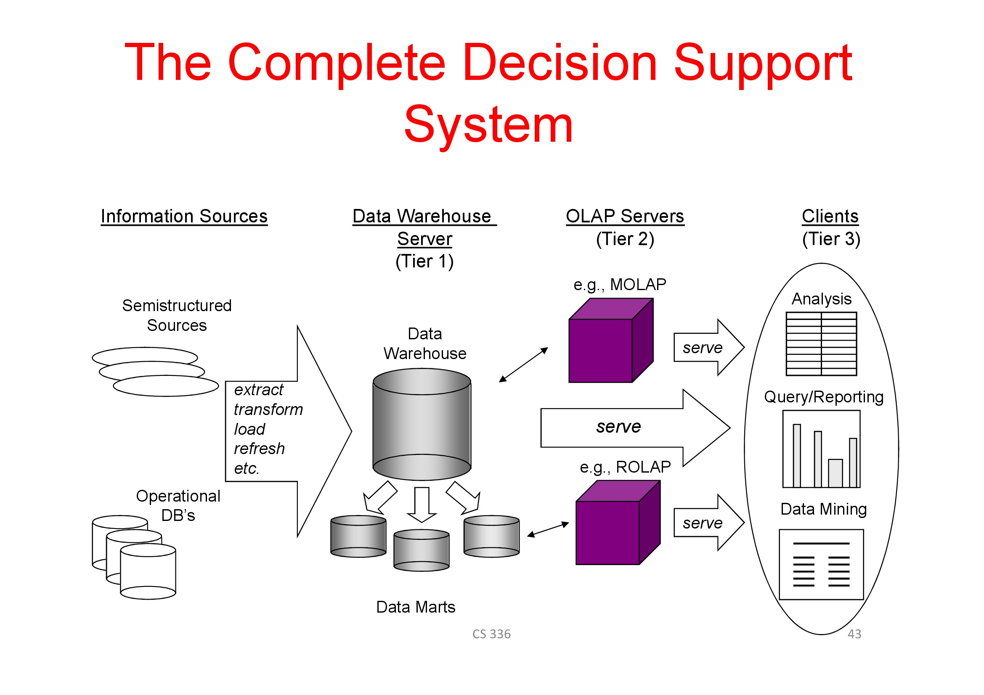

Slide 30

Example OLAP session
Show total sales of Iced Tea. “Dice” by item Iced Tea. Answer “$32M”.
Seems low who is not drinking? Show total sales of Iced Tea by country, drill down on place

Slide 31
Example OLAP session
What? Only $1M for New Zealand?

Slide 32

OK show me Iced Tea sales for New Zealand broken down by month
Sales dropping in June. Maybe it is geographic

Slide 33
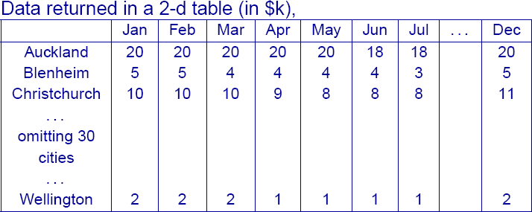
Show me Iced Tea sales for New Zealand cities, by month
Lots of variability, and drowning in data, roll up on place

Slide 34
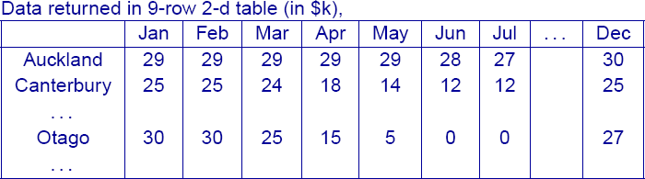
Show me Iced Tea sales for N.Z. “provinces”, by month
Not many sales in Otago in June and July
It is too cold then

Slide 35
OLAP session concludes
Decide to run the “10 unconventional uses for Iced Tea Mix” ad in Otago.
42

Slide 36
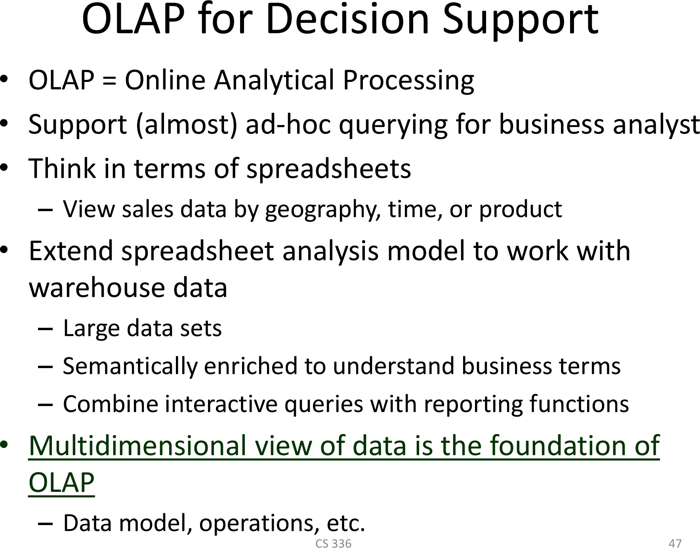

Slide 37
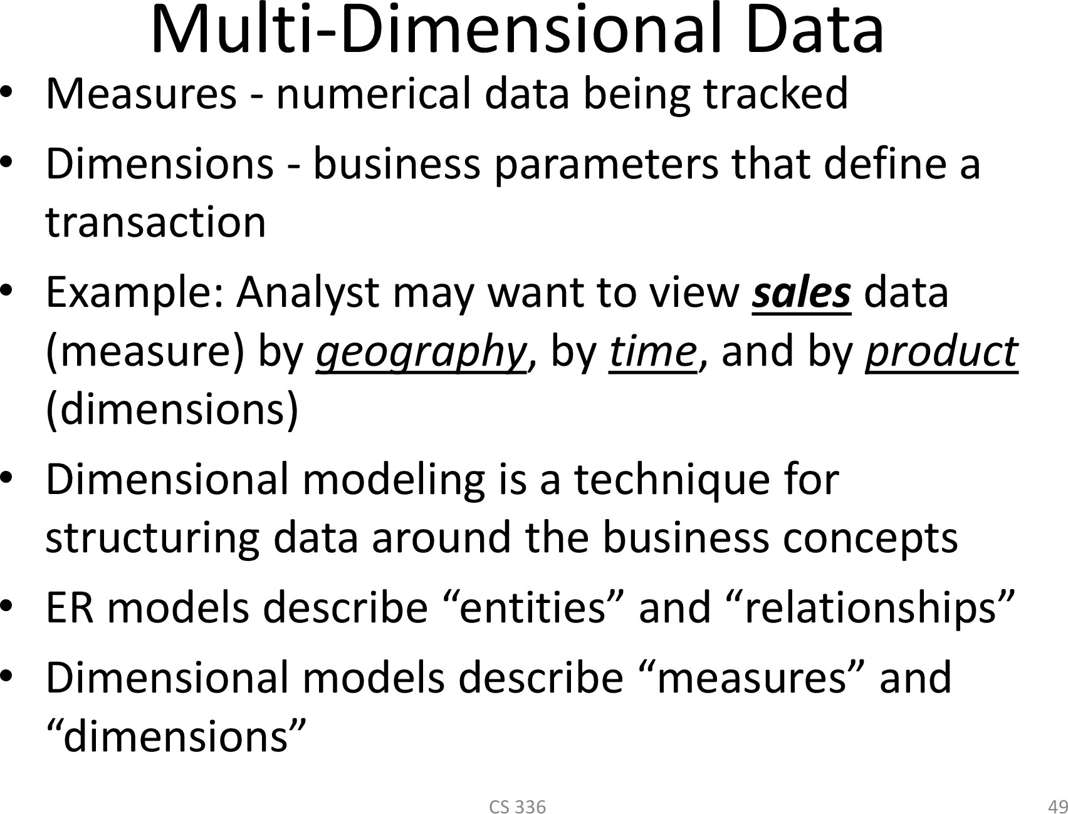

Slide 38
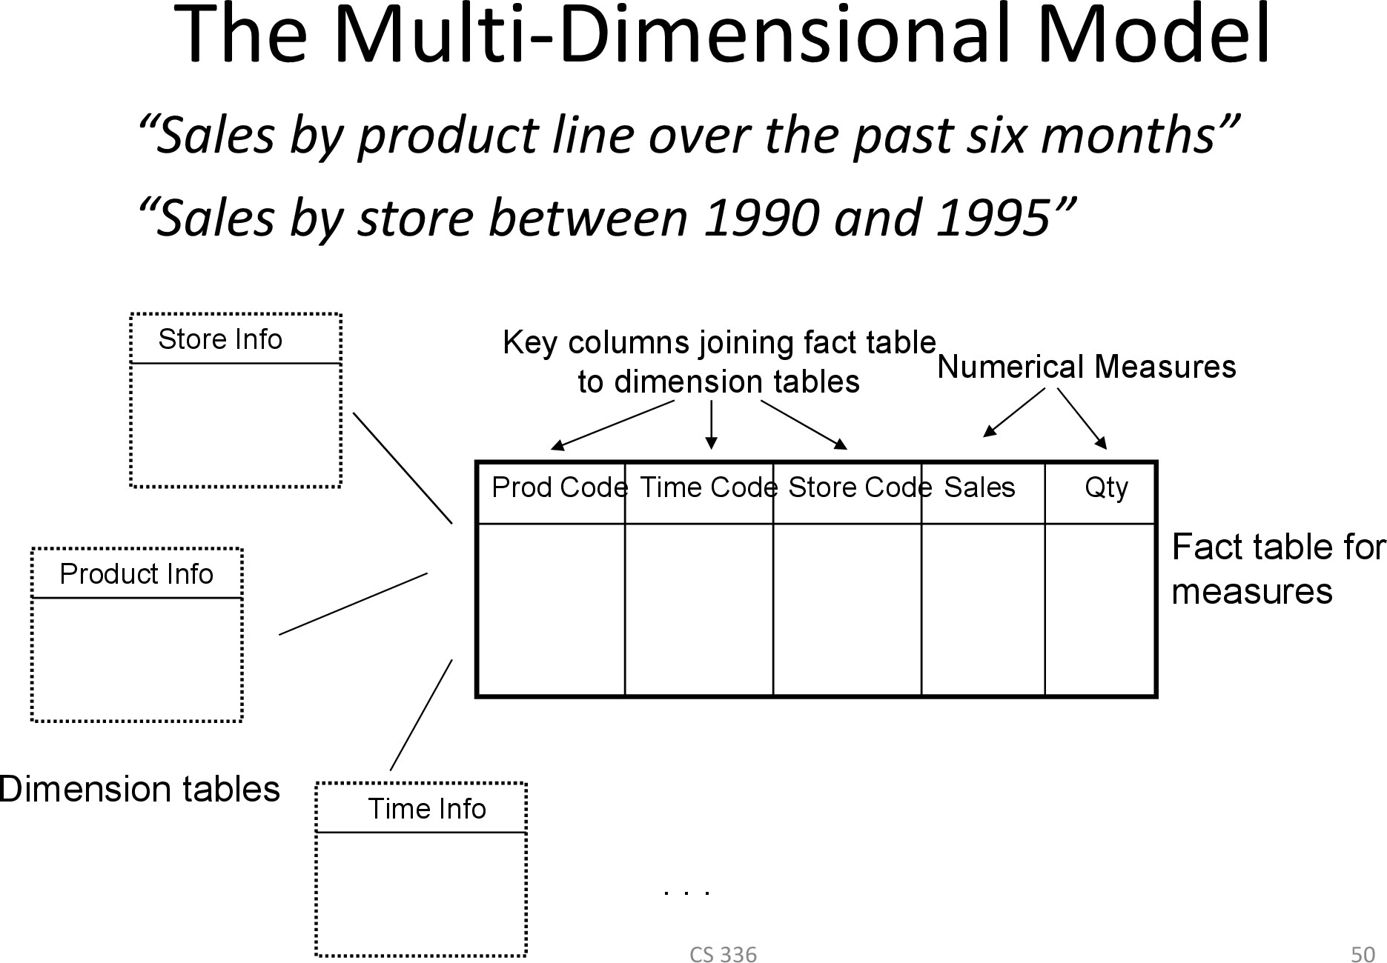

Slide 39
Rules for Dimensional Modelling
each dimension describes a “business entity”
dimensions involve attributes that provide the context for numeric data/measures
each dimension should have a single base level,
  “day” can be the base level for the “time” dimension
  “products” can be the base level for the “product” dimension
  “store” can be the base level for “location dimension

Slide 40
Analysis using a multidimensional database
Attribute Information associated with an object.
Variable A unit-bearing data type, either measured or derived
For our purposes, Variable = Attribute.
Dimension Collection of objects of the same type. Dimension values commenly organized into containment hieararchies

Slide 41
Dimensions
SCHEMA: ItemXPlaceXMonth!SalesAmont
INSTANCE: $24K Iced tea was sold in Aucland in January
Item: Iced Tea
Place: Aucland
Month: January
SalesAmount: $24K
Variable
Dimension
Measure

Slide 42
Rules for Dimensional Modelling
these base level elements can then be aggregated / summarized to more coarse- grained levels
  “days” weeks, months, quarter, year, ....
  “products” brand, food/non-food, supplier, ....
  “store” city, region, country, urban/rural, ....
dimension elements “make sense”, independent of other dimensions

Slide 43
Rules for Dimensional Modelling
each level is characertised by a (non- empty) set of attributes:
– in the “month” level, we group all those days together that coincide on their month and year attributes

Slide 44
Relational OLAP ROLAP
52

Slide 45
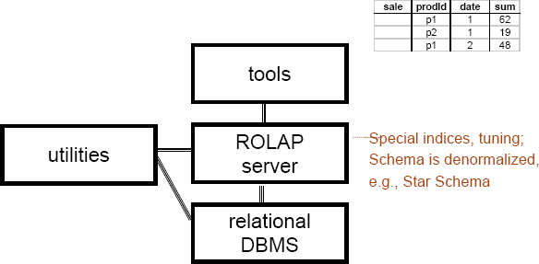
ROLAP Server Relational OLAP Server
54

Slide 46
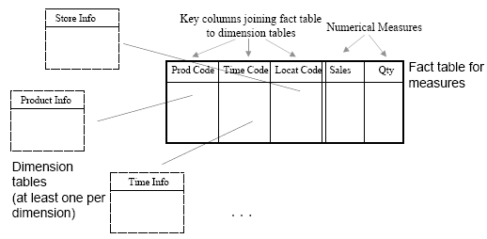
ROLAP: Dimensional Modeling Using
Relational DBMS mensional Model How do we store multidimensional data in a relational database?

Slide 47
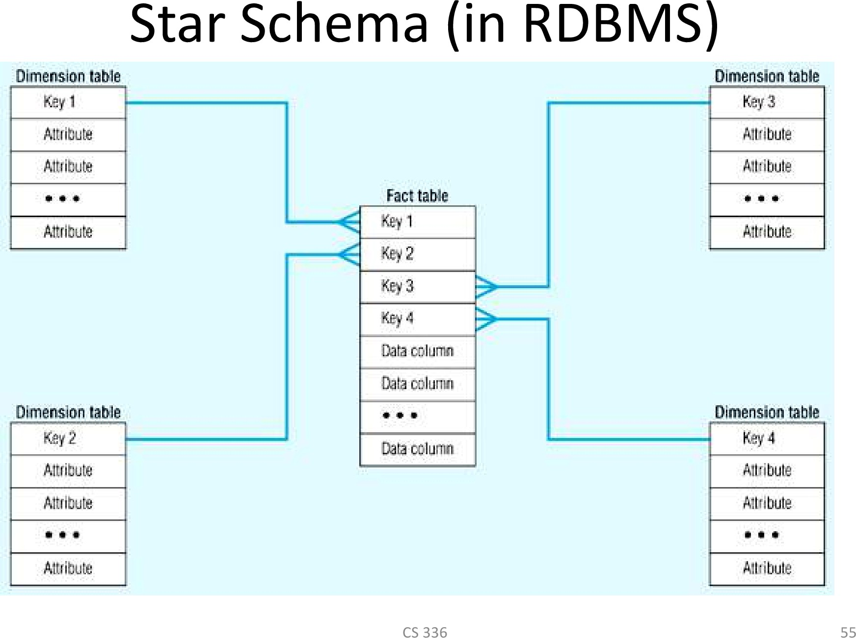

Slide 48
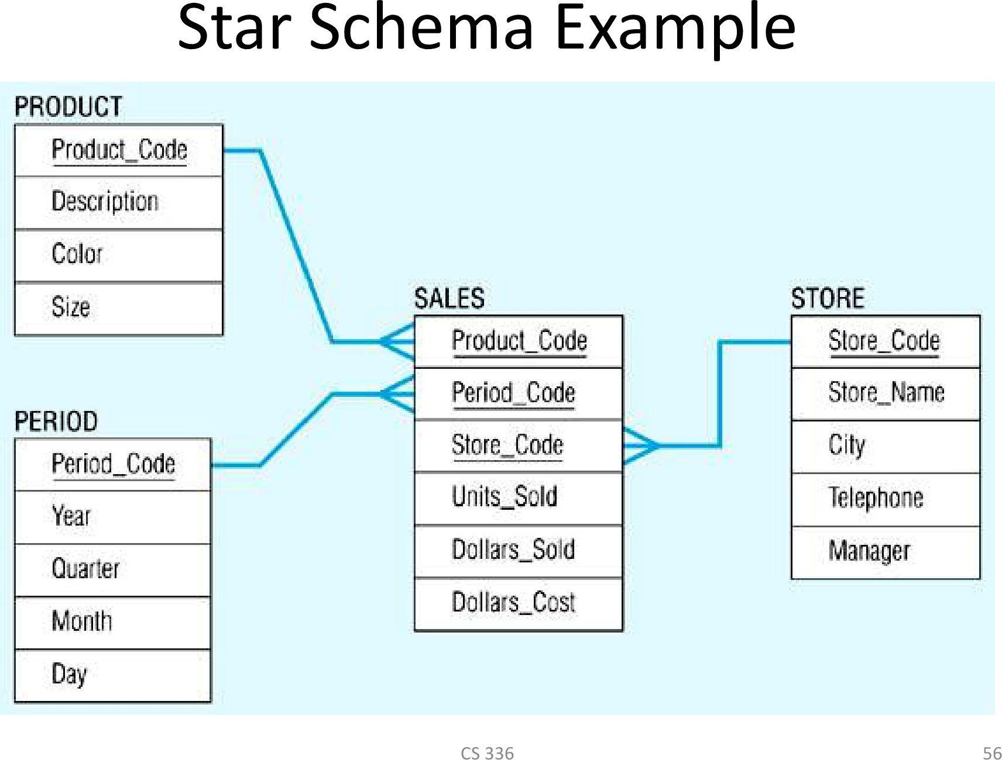

Slide 49
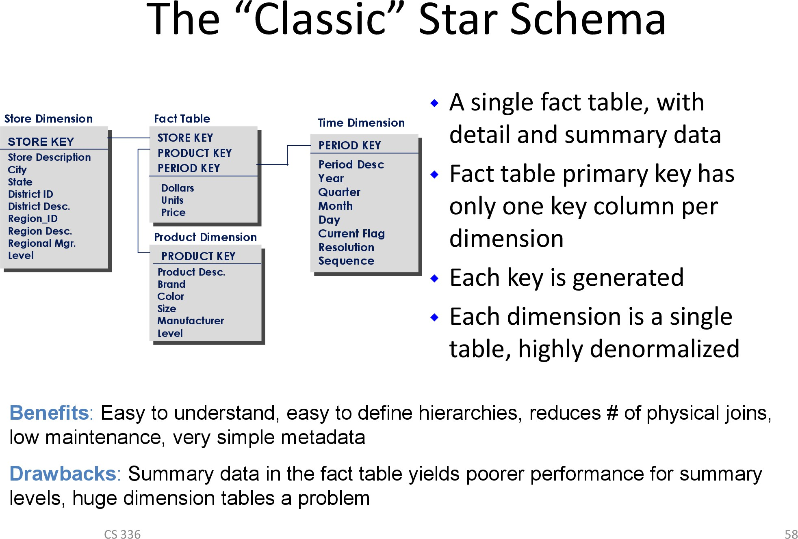

Slide 50
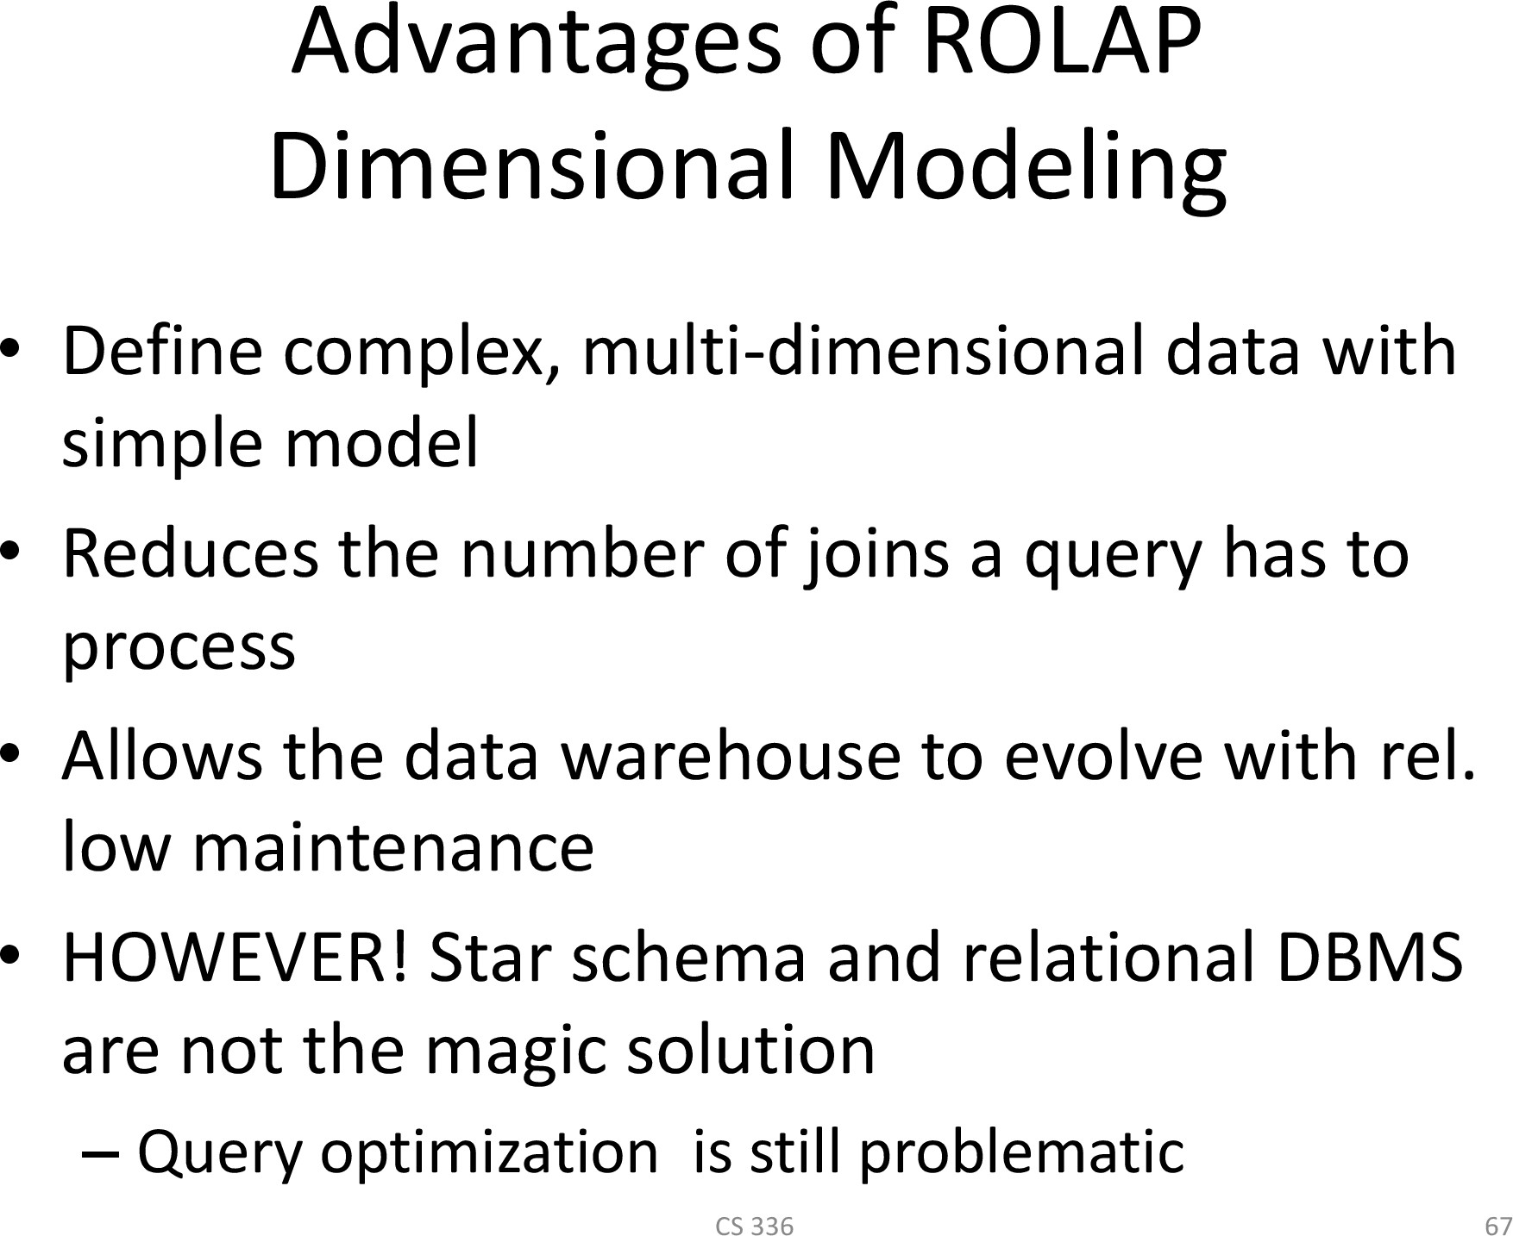

Slide 51
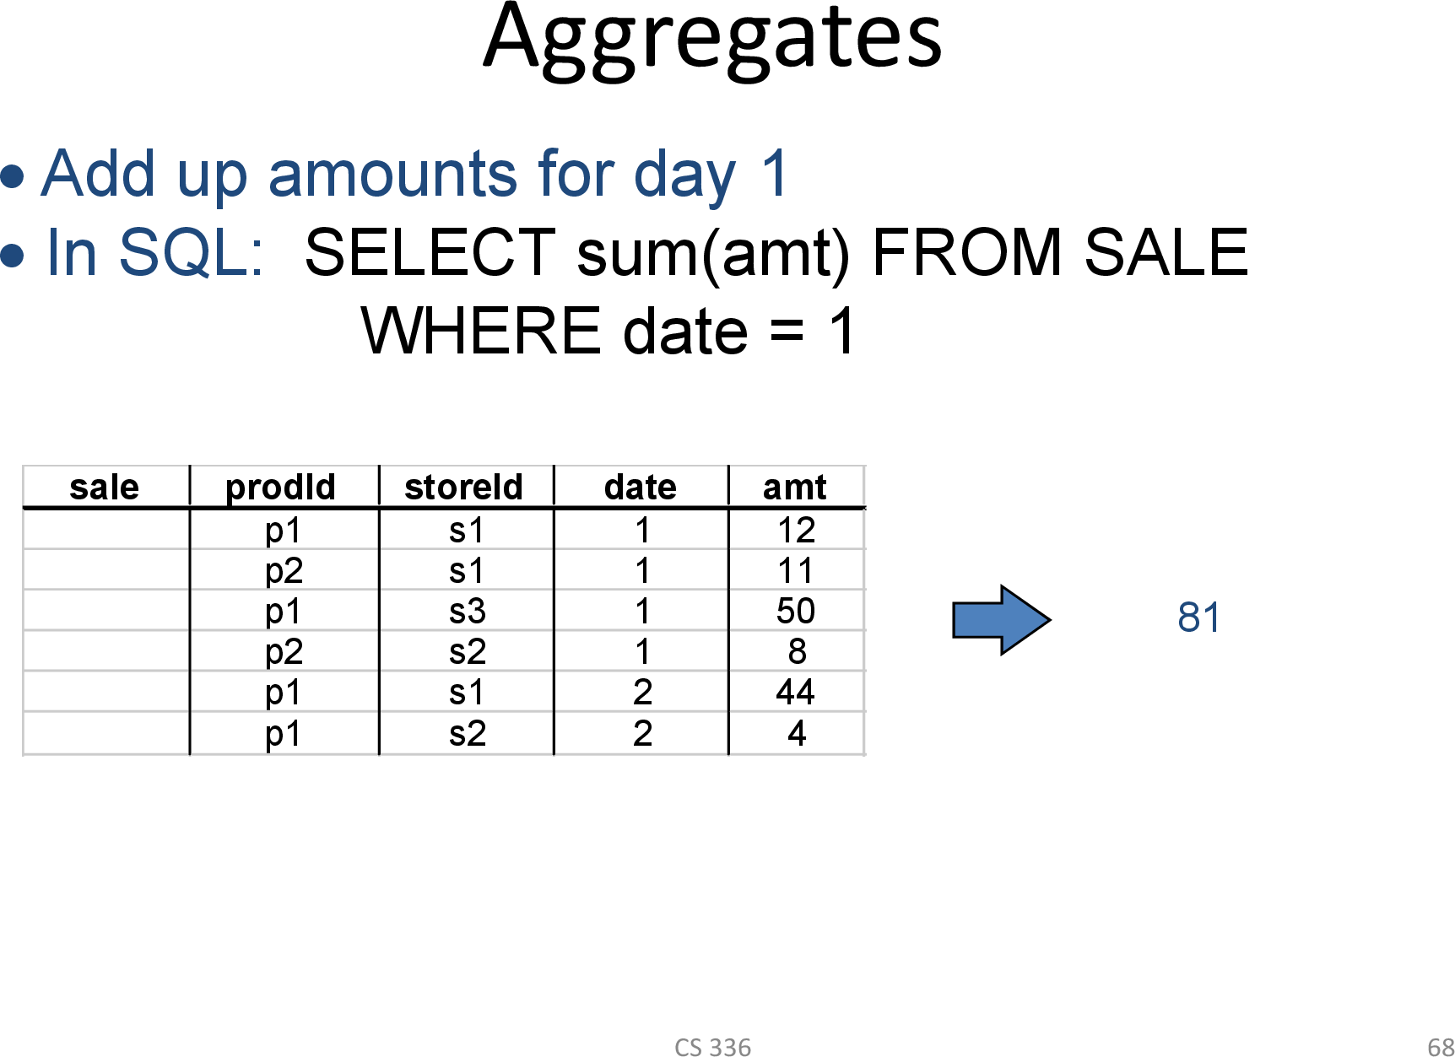

Slide 52
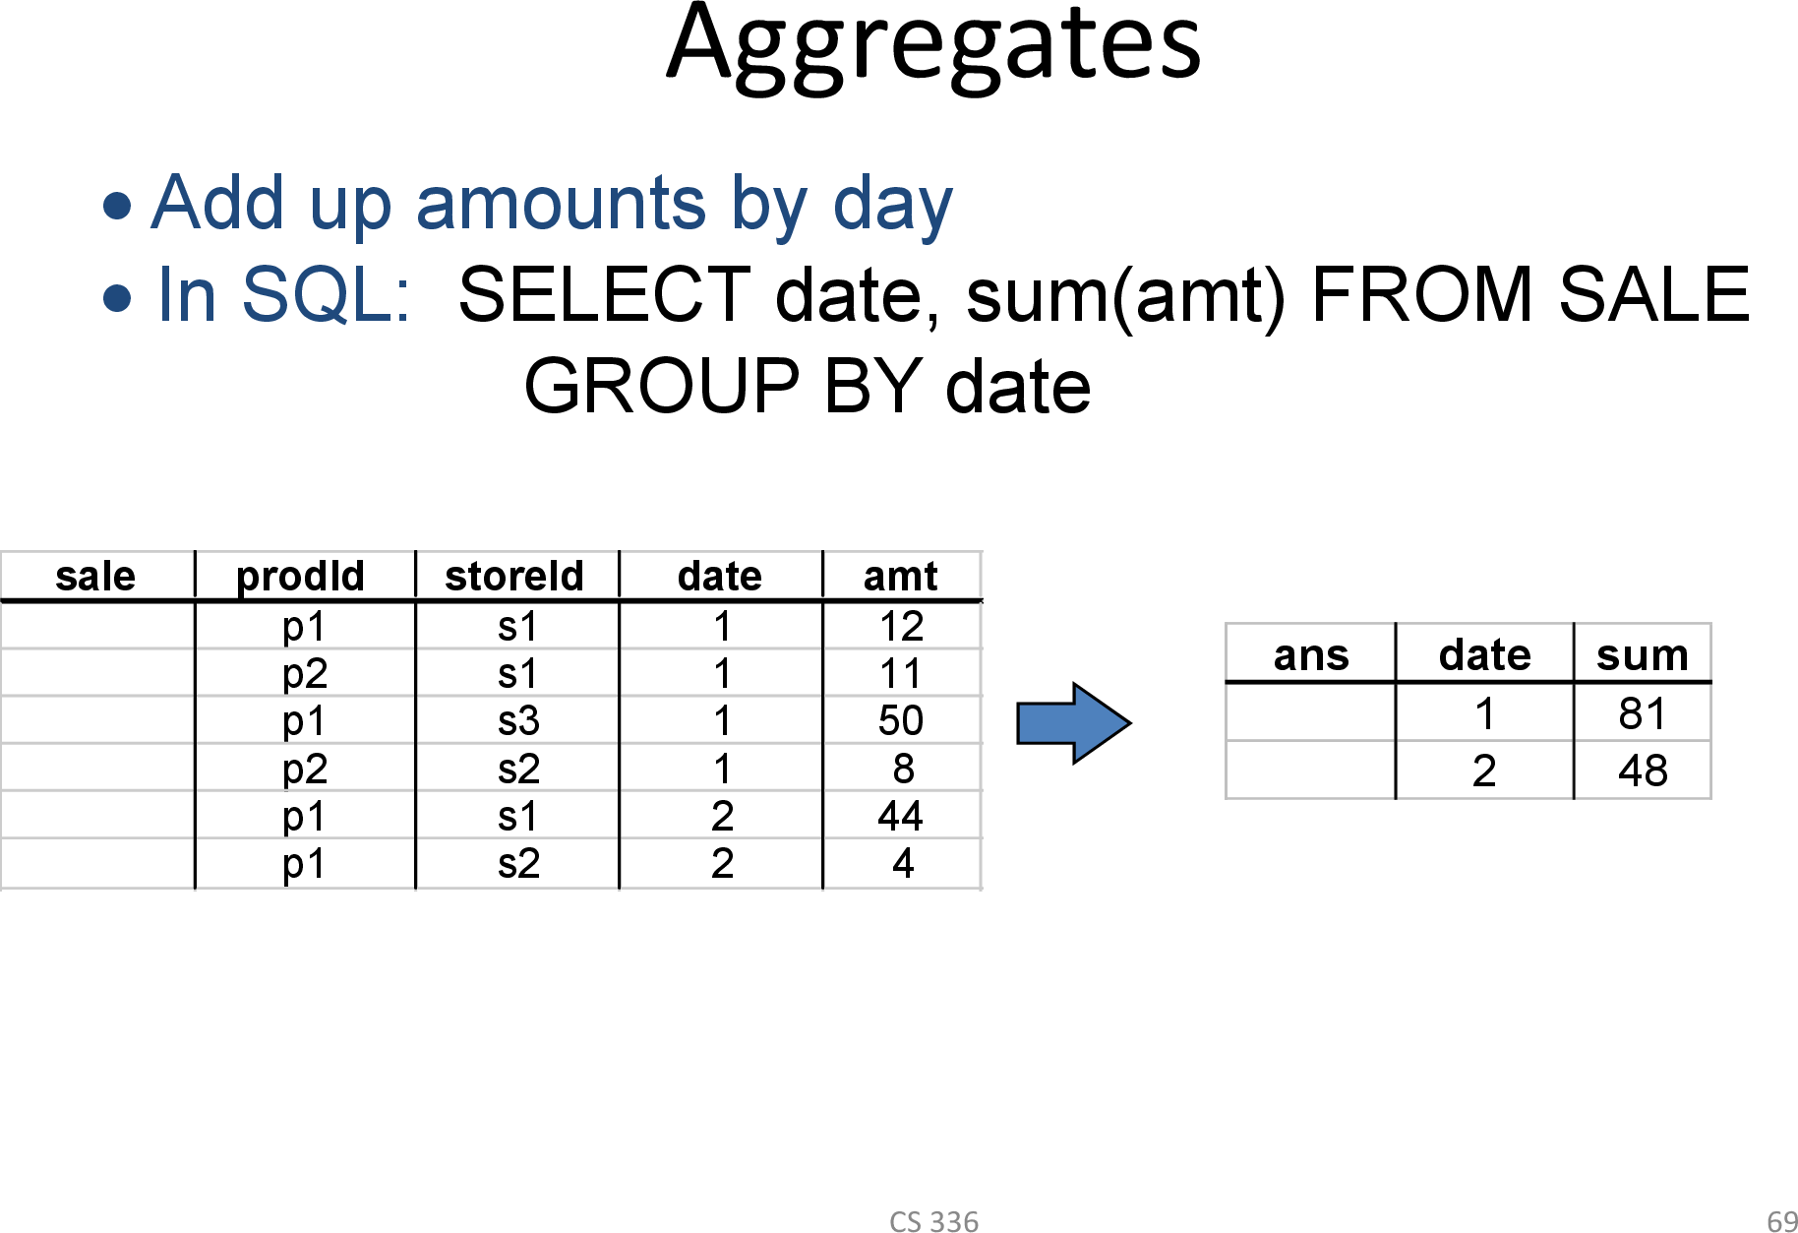

Slide 53
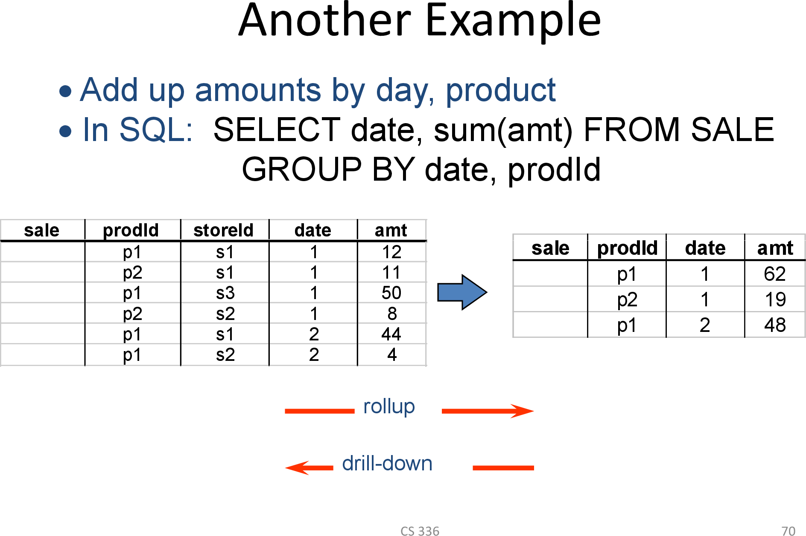

Slide 54
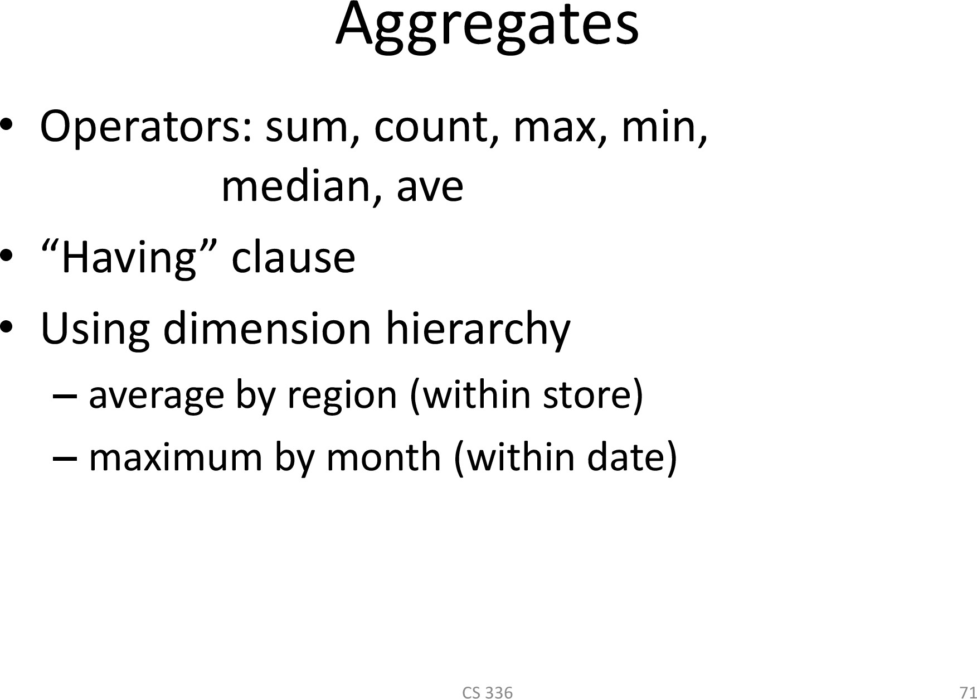

Slide 55
Multidimensional OLAP MOLAP
66

Slide 56
Multidimensional OLAP (MOLAP)
Array-based multidimensional storage engine
– sparse matrix techniques
fast indexing to pre-computed summarized data

Slide 57
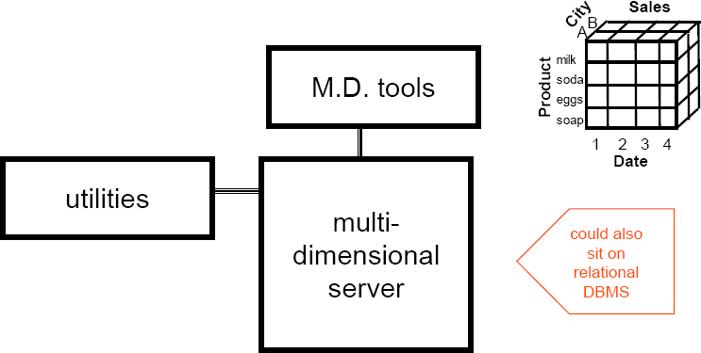
MOLAP Server
Multi-Dimensional OLAP Server

Slide 58
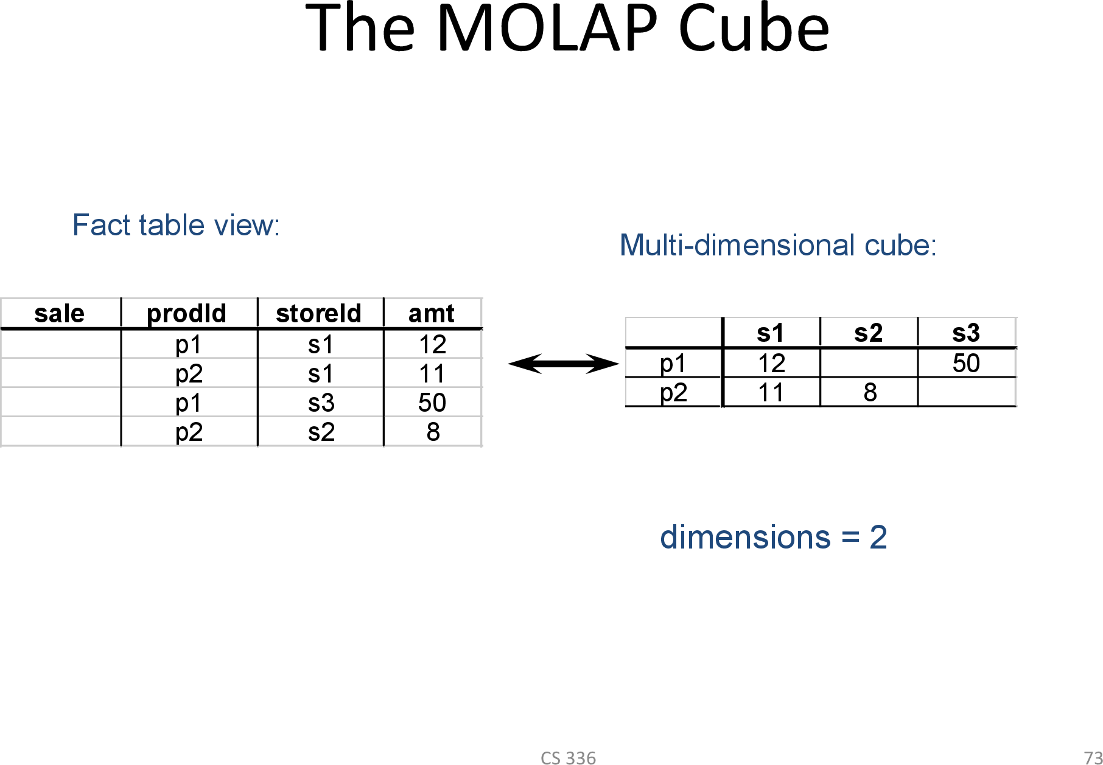

Slide 59
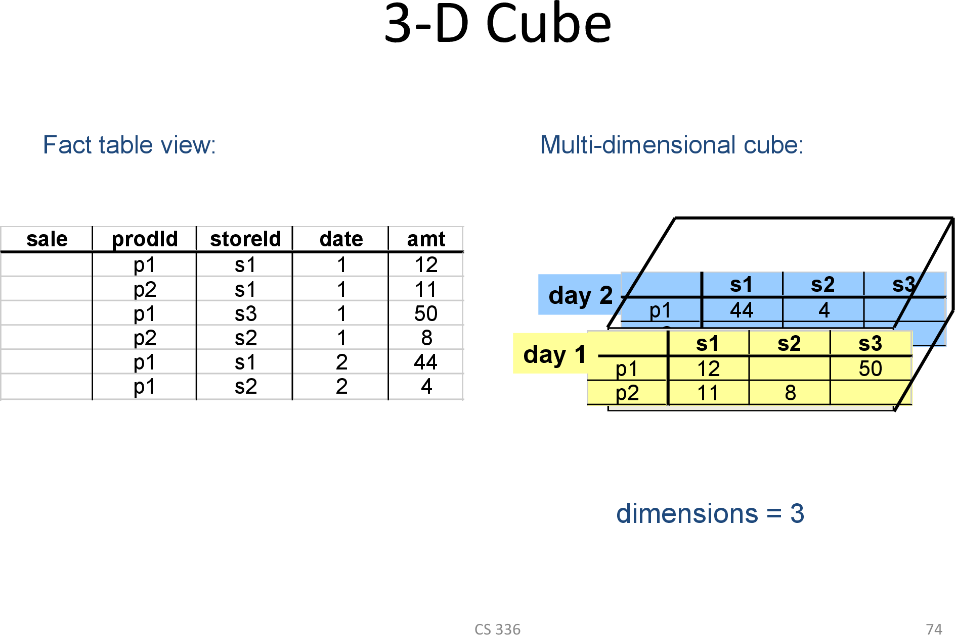

Slide 60
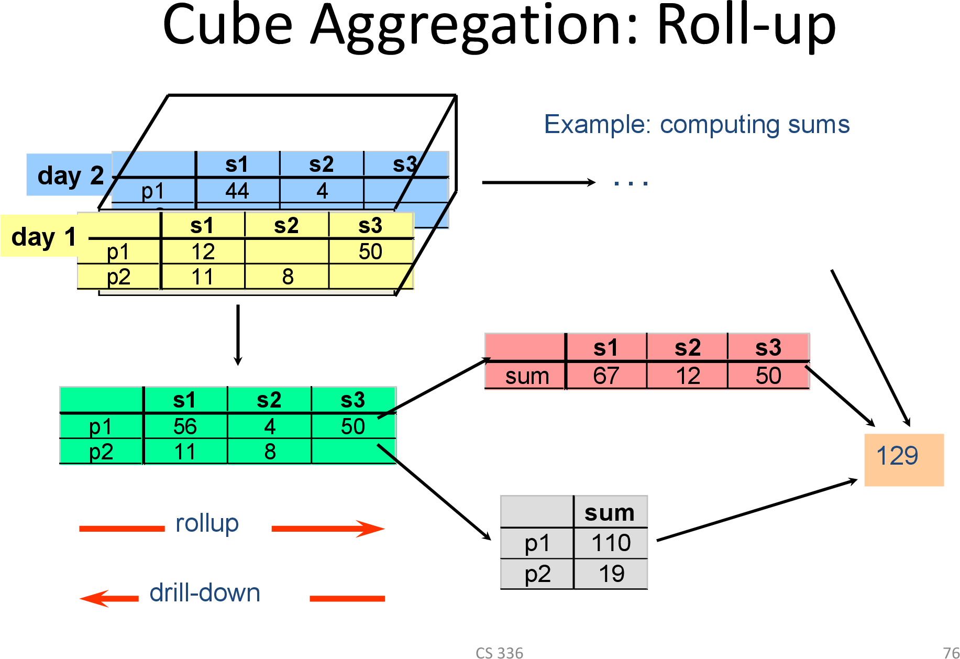

Slide 61
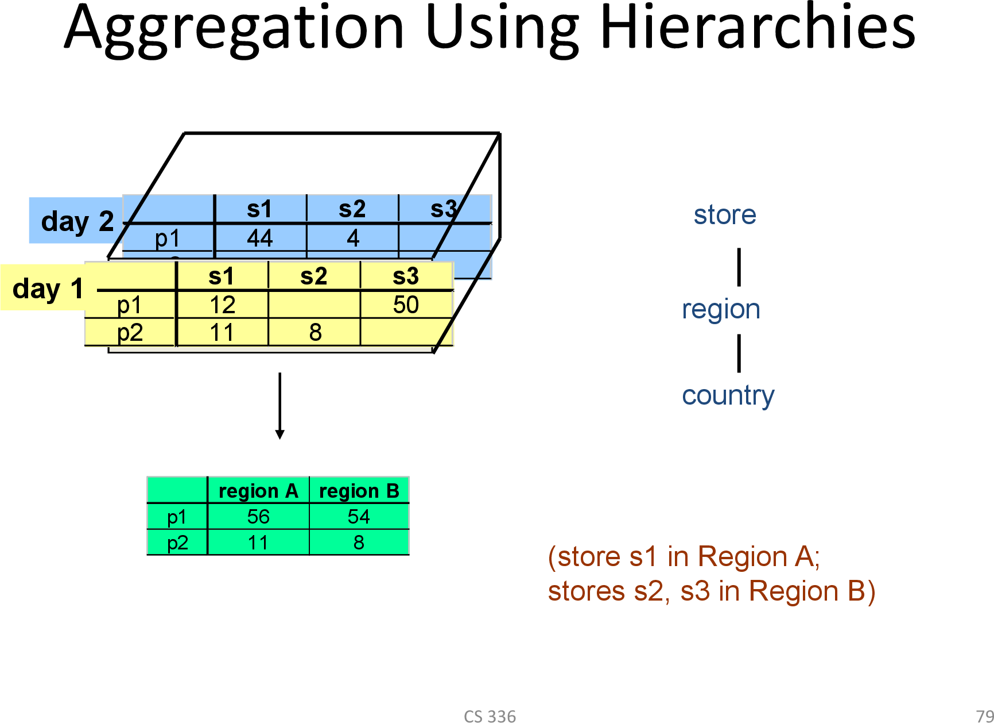

Slide 62
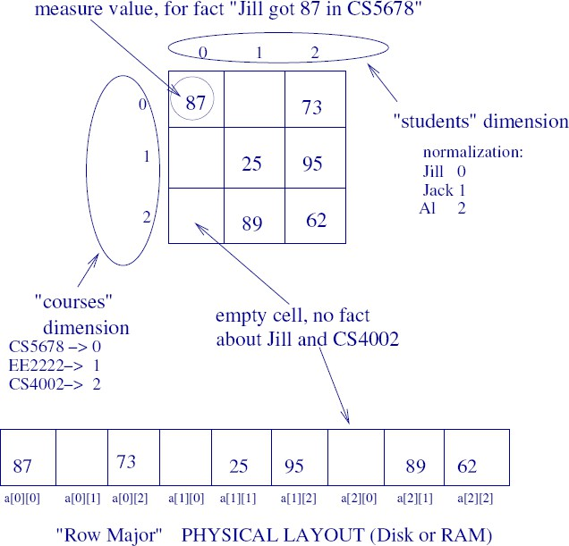
MOLAP
Example
Asst. Prof. Dr. Nerg
iz Ercil Çağıltay, Atılım University 30
75

Slide 63
HOLAP
HOLAP: do both (A hybrid approach)
HOLAP (Hybrid Online Analytical Processing) is a combination of ROLAP (Relational OLAP) and MOLAP (Multidimensional OLAP). HOLAP allows storing part of the data in a MOLAP store and another part of the data in a ROLAP store.
HOLAP can use varying combinations of ROLAP and OLAP technology. It typically stores data in both a relational database and a multidimensional database, depending on the preferred type of processing

